Slide 1
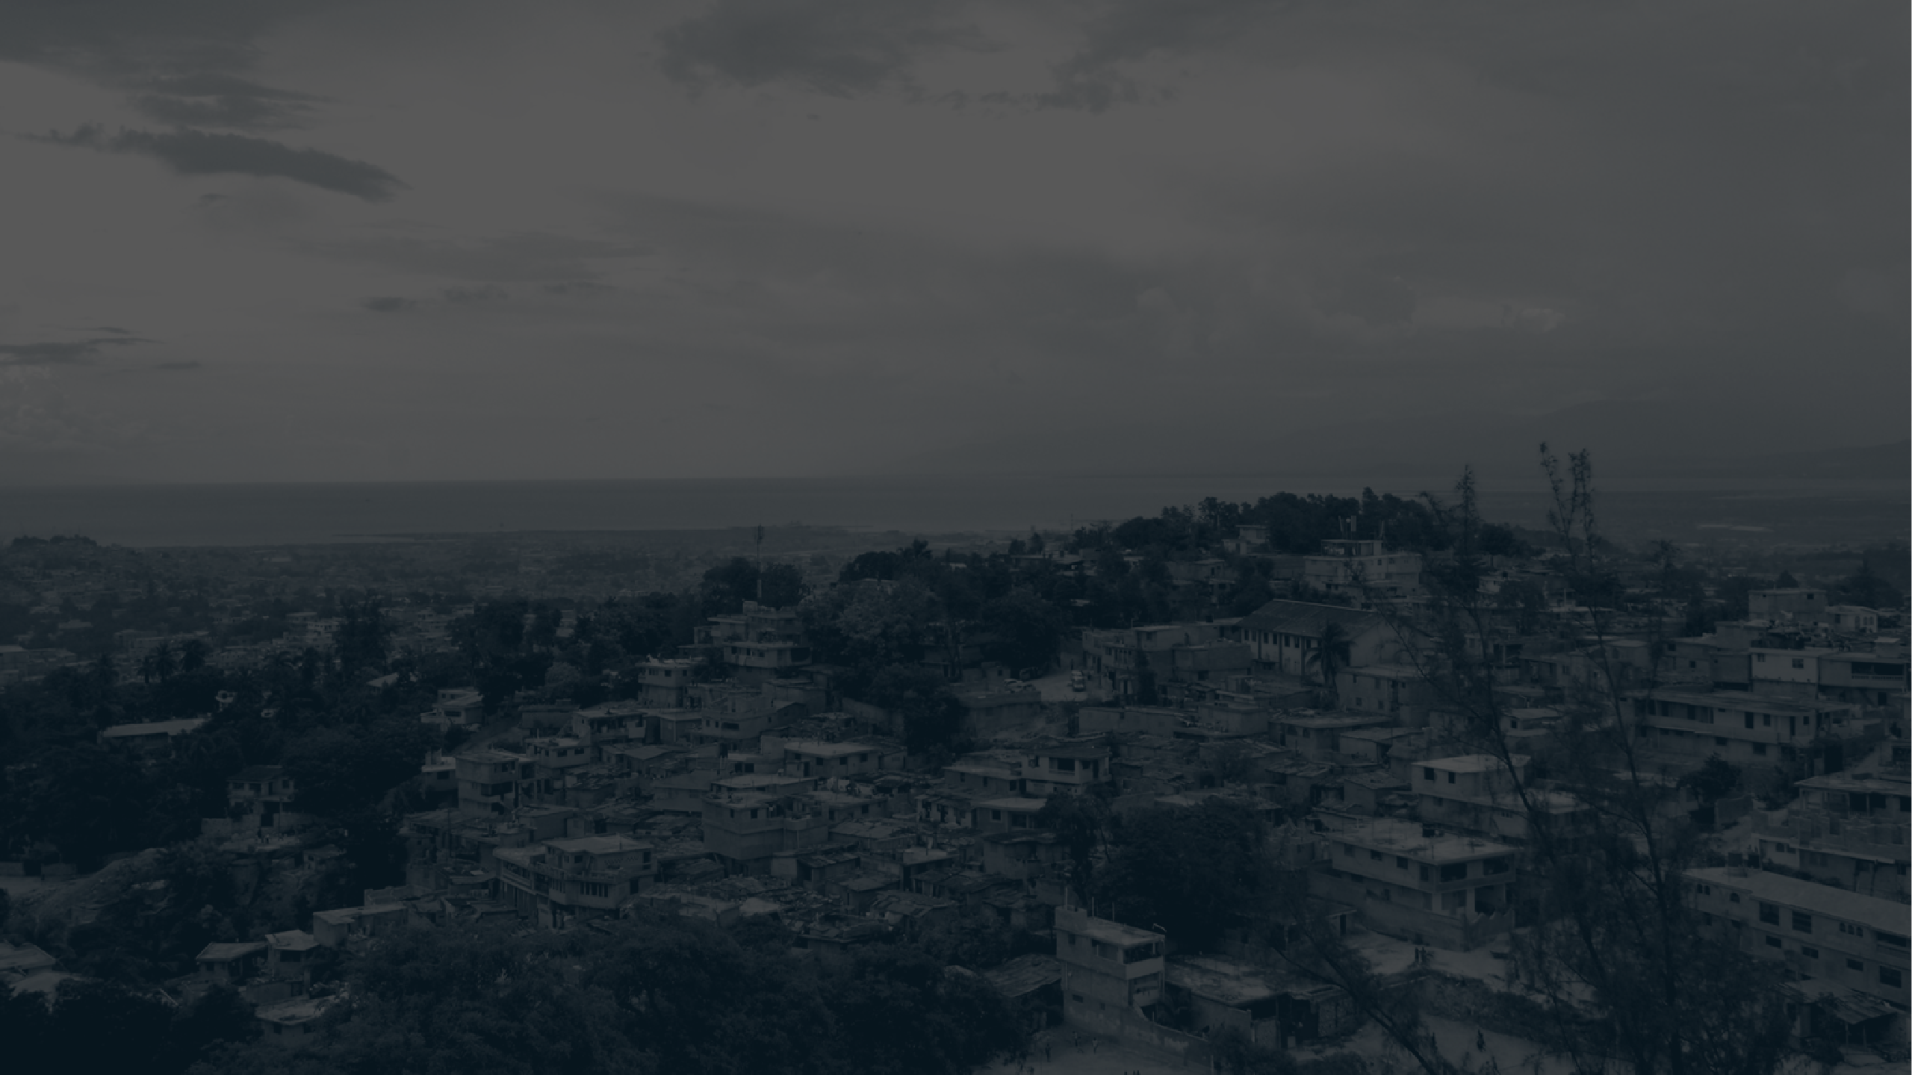
Empowering Families: Immigration Solutions and Safeguards
00000000000000000000000000000000000000000000000
Sandra Dieudonne, Esq.
This Photo by Unknown Author is licensed under CC BY-SA

Slide 2


AGENDA
Introduction
Humanitarian Crisis
Value Systems
Behavioral Patterns
Legal Remedies
Questions & Answers
This Photo by Unknown Author is licensed under CC BY-NC-ND

Slide 3
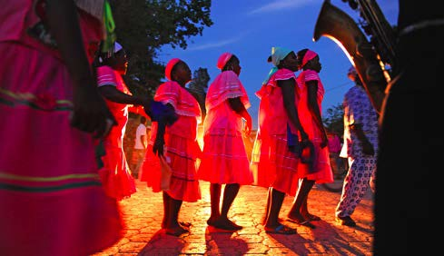

INTRODUCTION
This training program is specifically designed to address the needs of unaccompanied minors. It aims to offer valuable insights into various immigrant core values and provide caretakers, case workers, and staff with the necessary skills to effectively work with this population.
This Photo by Unknown Author is licensed under CC BY-SA
Notes:
Presenter
2024-04-15 21:29:07
--------------------------------------------
In Haitian culture it is believed that children are a gift from God or gods. At their youngest age, well before daycare and whatever the religion there are therefore inculcated love and respect for superior beings.

Slide 4



HAITIAN VALUES
Respect for adults, support to family, and doing well in school are strong values held in the Haitian culture.
Haitian parents believe in establishing discipline and moral development.
Haitian children are aware that discipline comes from parents, teachers, and from any adult in the community.
*Note that these are references to traditional values. Most Haitian children, in this last decade grew up in a context of torment, social changes, loss of respect for institutions, and various type of social, economic, sexual, physical, and psychological violence.

Slide 5
VALUE SYSTEMS
Children hold adults in the highest regard.
Many immigrant populations place a high value on education as a pathway to overcome poverty.
As a result, many young individuals are hesitant to engage with older generations or their peers if they feel academically inadequate.
*Note that these are references to traditional values. Most Haitian children, in this last decade grew up in a context of torment, social changes, loss of respect for institutions, and various type of social, economic, sexual, physical, and psychological violence.

Slide 6


BEHAVIORAL PATTERNS
In American culture, children typically respond to an authority figure when asked a question. However, in many Latino, African and Haitian cultures, children are taught to seek the approval of a parent or guardian before giving a response. For example, Haitians strongly believe in the importance of keeping family matters private and within the confines of the home.
In Haitian culture, it is considered a sign of respect for children not to interject in conversations between adults, even if they are familiar with the subject being discussed. On the other hand, in American culture, children are often encouraged to engage in adult dialogue and express their thoughts and opinion.

Slide 7



BEHAVIORAL PATTERNS…
In American culture, it is commonly taught that demonstrating respect towards authority figures involves making eye contact. However, in Haitian culture, children are instructed to lower their heads and avoid direct eye contact as a sign of respect. If a child looks directly at an adult, they are often told to "bese je ou", which means to lower your eyes.
7

Slide 8



HUMANITARIAN CRISIS IN HAITI
The surge in armed violence across Haiti has triggered a profound humanitarian crisis, with the number of internally displaced children soaring to 170,000. The current situation is placing an enormous strain on the already limited resources of host communities and existing social services. (UNICEF UK)
In Haiti, children and families are enduring relentless waves of brutal violence, with each day bringing new horrors, the loss of loved ones, homes being destroyed by fire, and an ever-present shadow of fear. (UNICEF)

Slide 9

HAITIAN CHILDREN’S EXPERIENCES IN HAITI
Tragically, children are being caught in the crossfire, suffering injuries, or losing their lives, with some incidents occurring in route to school. Furthermore, there are increasing instances of children being forcibly recruited, while others join armed groups driven by sheer desperation. (UNICEF UK)

Slide 10
HAITIAN CHILDREN’S EXPERIENCES IN HAITI
Many children are deprived of essentials like food, healthcare, and education. They are mired in a crisis that strips away the very essence of childhood. (UNICEF UK)
Witnessing or experiencing violence firsthand can have long-lasting physical, social, and psychological effects. Forced recruitment
into gangs is exposing them to the possibility of greater levels of violence and exploitation. Displacement and migration caused by the current volatile situation can separate children from their families and caregivers, putting them at higher risk of abuse. (World Vision)

Slide 11


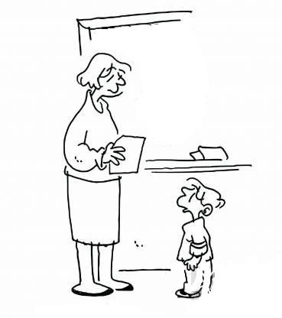



CONFIDENTIALITY

Slide 12
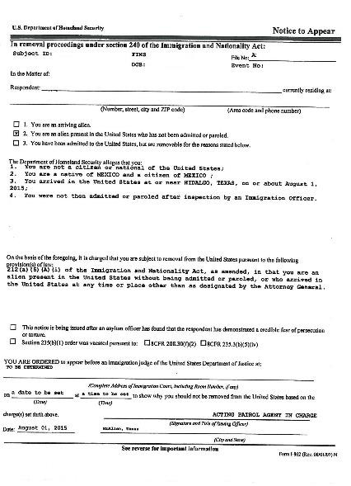

NOTICE TO APPEAR
(NTA)
You are not a citizen or national of the United States;
You are a native and citizen of:
Guatemala, Honduras, El Salvador, México etc.
You arrived in the U.S on (Date
that the Department of Homeland Security believes that you came to the United States).
You were not admitted into the
United States (entered without inspection/permission)
An immigration case opens and an A# is assigned.

Slide 13


C A N I W OR K IN T H E U N IT E D S T AT E S ?
Immigrants (non-citizens) need authorization from the United States government (called a “work permit”) to legally work in the United States.
Working without a work permit could complicate your immigration case or cause other legal problems. Everyone who works in the United States has labor rights that protect against exploitation and discrimination even if you do not have a work permit.

Slide 14

THE FOLLOWING ARE EXAMPLES OF BEHAVIORS THAT MAY BE VIOLATING YOUR RIGHTS AT WORK:
Violence or threats of violence
Sexual harassment
Threats of deportaiont
Threats to call the police
Threats to harm your family
Not being allowed access to your phone, ID, or other personal belongings
Dangerous working conditions
No days off
No breaks for meals or bathroom
Being required to miss school if you’re a minor
Being told to lie about your age
Not getting paid
If you experience any of these or other behaviors while working in the United States, it is important that you talk to an attorney.

Slide 15
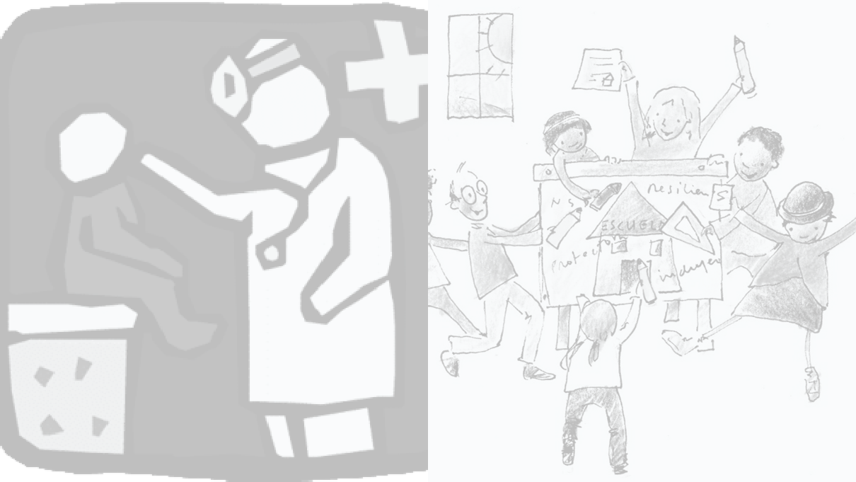
BASIC RIGHTS
✓Food
✓School
✓Recreation; decision to go or not to go to church
✓Contact with your family
✓Medical care
✓Right to speak to an attorney
✓Right not to speak to anyone if you don't want to
✓Reunification with your family or sponsor
✓To be respected, cared for and protected in the shelter. NO to sexual abuse or sexual harassment
✓Right to decide about your pregnancy
✓Right to Request a Flores Court Hearing for a Custody Redetermination
No one can deny your basic rights
Notes:
Presenter
2024-04-15 21:29:16
--------------------------------------------
An important question? You are not citizens of the United States, correct? And you do not have a visa or permission to be in this country, correct? Well the question is. Do you think you have rights? Who says we have no rights? But of course we do have rights? Even if you are not a citizen of this country, NOBODY can deny you basic rights. The shelter has to protect those basic rights. But it is also very important that you behave well and follow the rules of the shelter/home. And the shelter gives each of you a case manager/social worker who will help you reunite with your parents/relative/or sponsor here in the United States. What if they don't know anyone in this country? Are they going to stay in the shelter/home forever? Do not stop minors who do not know anyone there are other alternatives to stay with a family in a foster home.

Slide 16
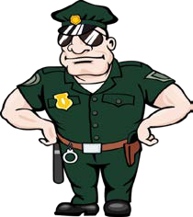

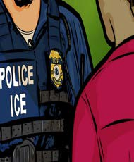
U.S. Customs and Border Protection
is responsible for securing the border between Mexico and the United States; which also includes detaining anyone who enters the United States without legal documents.
CBP
IMMIGRATION AGENCIES
Immigration and Customs Enforcement
•It is responsible for enforcing immigration laws within the United States.
•is responsible for expelling any person who is present in the United States without documents
ICE

Slide 17
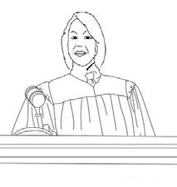







Judge
Interpreter
Sponsor/relative
Trial Attorney for the Department of Homeland Security (ICE/CBP/DHS)
IMMIGRATION COURT
Minor
Attorney
Notes:
Presenter
2024-04-15 21:29:16
--------------------------------------------
Are you required to go to the court date? Yes, it is very important that you go to the court date. What will happen in court? It will be decided if they stay or have to go to their country. When do you have to go to court? One of the documents they signed when immigraton stopped them is called NTA (Notice to Appear) This document is important because it has your #A number (your case number identification in the immigration court. What information is in this document? Your name, your country of origin, where you entered the United States. This document also says the reason why the United States government wants to deport you. That is, the charges against you. Who will be in court? The judge /the judge will decide your case. The government/immigration lawyer. You and your lawyer. And there will be an interpreter in court who will translate for you what is happening in your case, the judge's questions/ The judge and her answers. Let's imagine it's like a soccer match. There are 2 teams. Which team do you want to be Real Madrid? Or Barca? And the one with the immigration attorney? Well then, what does our team have to do? so that we don't lose the match. Have a good strategy with the aid Help from your lawyer. What do we have to do so they don't score goals? Have a good defense. Well then like a football game this side (the government/trial attorney) is attacking us with the charges. And we have to defend ourselves with the help of our lawyer. And then who decides your case? In the football game who decides if there is a foul? The referee is the judge. In this game the one who decides will be the judge. And it is not on either of the two teams. The judge has to be neutral and listen to both sides before making a decision. And the defense process will be a long process that will not be decided in the first court date.

Slide 18


What happens if I don't show up for my court date?
➢The judge will issue a deportation order in absentia (in your absence)
What if I don't have an attorney at my first court date?
➢You can ask for more time to find an attorney
Where will I go to immigration court?
➢The court hearings will be in the immigration court closest to where you are living
What if for some reason I cannot find an attorney?
➢You have the right to explain that you have tried to get an attorney. You may have to speak for yourself if the judge asks you questions.
Notes:
Presenter
2024-04-15 21:29:17
--------------------------------------------
This is another option for an Overview slide.

Slide 19
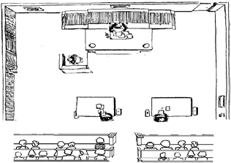





QUESTIONS FROM THE JUDGE
Full Name
Age Sponsor/Relationship
Are your in school?
Do you have an attorney?
Minor’s Address

Slide 20


✓Do you have a visa or permission to stay in the United States when you reunify with your family members or sponsors?
✓What happens if you don't go to your immigration court hearing?
✓What is a visa?
Juvenile Visa
Asylum
Family Petition
T-VISA
U-VISA
VAWA

Slide 21

Are you required to go to court?
Who decides if you can stay in the
U.S. or not?
What happens if you miss your immigration court date?
What if you don't have an attorney by your first court date?
Is the United States government going to give you an attorney to represent you?

Slide 22
SPECIAL IMMIGRANT JUVENILE VISA
Under 18 (or under 21 years of age in some states)
Unmarried
It would not be in your best interests to return to your native country
A state court has taken up the case Suffered (By one or both of your parents)
Abuse/Mistreatment
Abandonment
Neglect
Something similar under state law

Slide 23








ASYLUM
You do not want or cannot return to your home country because someone or some group wants to harm you, or has already harmed you because of your:
Religion Political Opinion Race/Ethnicity Nationality
Particular Social Group
Notes:
Presenter
2024-04-15 21:29:22
--------------------------------------------
Keep it brief. Make your text as brief as possible to maintain a larger font size.

Slide 24
TEMPORARY PROTECTEED STATUS (TPS)
TPS is a temporary, nonimmigrant status. The Secretary of DHS can designate a country for TPS due to conditions in the country that prevent its nationals from returning safely, e.g., natural disasters, wars, epidemics, etc.
INA § 244(b)(1)(A)-(C).
Notes:
Presenter
2024-04-15 21:29:22
--------------------------------------------
Keep it brief. Make your text as brief as possible to maintain a larger font size.

Slide 25
BENEFITS OF TPS
During a designated period, individuals who are TPS beneficiaries or who are found preliminarily eligible for TPS upon initial review of their cases (prima facie eligible):
Are not removable (cannot be deported) from the United States
Can obtain an employment authorization document (EAD)
May be granted travel authorization
Once granted TPS, an individual also cannot be detained by DHS on the basis of his or her immigration status in the United States.
Risks:
If the TPS application is denied, an applicant may be referred to removal proceedings which may lead to detention and removal.

Slide 26
FACTS ABOUT TPS
TPS is a temporary benefit that does not lead to lawful permanent resident status or give any other immigration status. However, registration for TPS does not prevent an individual from:
  Applying for nonimmigrant status
  Applying for adjustment of status based on an immigrant petition
  Applying for any other immigration benefit or protection for which s/he may be eligible
Risks:
If the TPS application is denied, an applicant may be referred to removal proceedings which may lead to detention and removal.

Slide 27

TPS ELIGIBILITY
To be eligible for TPS, a person must:
Be a national of a TPS-designated country or have last resided in the country as a person w/out a nationality.
Apply for TPS during the open initial registration or re-registration period or be eligible for late initial filing.
Have been continuously physically present in the U.S. since the most recent designation date of the country.
Have been continuously residing in the U.S. since the date specified for the country.
Be admissible as an immigrant, with exceptions.

Slide 28
Countries Currently Designated For TPS
Afghanistan
Burma (Myanmar)
Cameroon
El Salvador
Ethiopia
Haiti
Honduras
Nepal
Nicaragua
Somalia
South Sudan
Sudan
Syria
Ukraine
Venezuela
Yemen

Slide 29

Eligibility Requirements for DACA
Were under the age of 31 as of June 15, 2012 (that is, you were born on or after June 16, 1981);
Came to the United States before reaching your 16th birthday;
Have continuously resided in the United States since June 15, 2007, up to the time of filing your request for DACA;
Were physically present in the United States on June 15, 2012, and at the time of filing your request for DACA with USCIS;
Had no lawful immigration status on June 15, 2012, and at the time of filing your request for DACA, meaning that:
  You never had a lawful immigration status on or before June 15, 2012, or
  Any lawful immigration status or parole that you obtained had expired as of June 15, 2012, and
  Any lawful status that you had after June 15, 2012, expired or otherwise terminated before you submitted your request for DACA;
Are currently enrolled in school, have graduated or obtained a certificate of completion from high school, have obtained a General Education Development (GED) certificate, or are an honorably discharged veteran of the United States Coast Guard or armed forces of the United States; and
Have not been convicted of a felony, significant misdemeanor (that is, a misdemeanor as described in 8 CFR 236.22(b)(6)), or 3 or more other misdemeanors, and do not otherwise pose a threat to national security or public safety.

Slide 30
T-VISA
Pressured
Forced/Coerced
Victims of human trafficking (labor or sex)
Fraud

Slide 31
U-VISA
Victims of serious crimes in the
United States
A minor may also qualify for a U-Visa if their parents have been victims of a crime in the United States and if they have cooperated with the police.
Suffer psychologically or physically
Make police report
If you have been the victim of a crime at the shelter, you have the right to speak to an attorney and file a police report.
Certificate certifying that you helped with the investigation

Slide 32

FAMILY PETITION
Family members of permanent legal residents or citizens of the United States
Son/Daughter
or sibling over 21 years of age

Slide 33







VAWA
Victims of Domestic Violence in the United States
Caused by a permanent legal resident or citizen of the United States
Son/Daughter
Parent/Stepparent
Spouse

Slide 34
Voluntary Departure
Deportation
The minor wants to return to their country. Must wait for an immigration hearing to be scheduled.
An immigration judge signs a voluntary departure order and gives up to 120 days to leave the United States.
A flight ticket is purchased to leave the country, and upon arrival, the minor presents themselves at the US embassy of their country of origin.
NO PENALTY - You may legally enter by applying for a visa in the future.
The minor did not appear for their immigration court hearing.
The immigration judge decides not to give more time or denies legal remedy (visa)
PUNISHMENT of 10 years where the person cannot enter the U.S. or apply for a visa.
If person returns to the U.S. after receiving the deportation order, they will receive another 10 years of punishment and jail time.
Notes:
Presenter
2024-04-15 21:29:24
--------------------------------------------
Last resort if you don’t have any other options.

Slide 35
Immigration fraud" means immigration legal services-related scams that target vulnerable immigrant New Yorkers. Immigration fraud, as described here, can be by attorneys and non-attorneys. It can also be by others who engage in other fraudulent acts such as phone scams and impersonations threatening immigration consequences.

Slide 36

“NOTARIO PUBLICO”
In many Latin American countries, the term “notario público” (which is Spanish for “notary public”) means something different from what it means in the United States. In many Spanish-speaking nations, “notarios” are powerful attorneys with special legal credentials.
In the United States, however, notary publics are people authorized by state governments to witness the signing of important documents and to administer oaths but are not necessarily authorized to provide legal services.
A notario público is not authorized to provide you with any legal services related to immigration. Only an attorney or an accredited representative working for a Department of Justice (DOJ)-recognized organization can give you legal advice. Beware of individuals who pose as immigration attorneys (such as unlicensed or disbarred attorneys).
States Coast Guard or armed forces of the United States; and
Have not been convicted of a felony, significant misdemeanor (that is, a misdemeanor as described in 8 CFR 236.22(b)(6)), or 3 or more other misdemeanors, and do not otherwise pose a threat to national security or public safety.
Credit: https://www.uscis.gov/scams-fraud-and-misconduct/avoid-scams/common-scams

Slide 37

“JOB OFFER SCAMS”
Beware of companies offering a job in the United States from overseas or by email. If you receive a suspicious job offer by email before you leave your country to come to the United States, it may be a scam, especially if you are asked to pay money to receive a job offer.
If you see a job offer on social media, make sure the company is legitimate before sharing any of your personal information.
Even if a job offer is legitimate, you are not allowed to work in the United States unless you have a Green Card, an EAD, or an employment-related visa that allows you to work for a particular employer.
Credit: https://www.uscis.gov/scams-fraud-and-misconduct/avoid-scams/common-scams
This Photo by Unknown Author is licensed under CC BY-SA

Slide 38

AFFINITY GROUP IMMIGRATION FRAUD
This involves providers who target immigrants belonging to their same ethnic or racial group. Accordingly, they seek to gain advantage over other providers by claiming to identify with the ethnic, racial, national origin or community-based affiliations of the immigrant group.
Do not pay for or submit any form until USCIS publishes a Federal Register notice with official TPS re-registration information for your country.
Please note that beneficiaries under the processes for Cubans, Haitians, Nicaraguans, and Venezuelans are not obligated to repay, reimburse, work for, serve, marry, or otherwise compensate their supporter in exchange for the supporter filing Form I-134A, on their behalf or for providing financial support while they are in the United States.
Access to these processes for Cubans, Haitians, Nicaraguans, and Venezuelans is free. Neither the supporter nor the beneficiary is required to pay the U.S. government a fee for any part of this process.
Beware of any scams or potential exploitation by anyone who asks for money associated with applying under this process. DHS recommends the following actions:
Avoid individuals who promise to “get you to the United States quickly” if you pay a large sum of money;
Keep your passport and other identity documents in your possession at all times; and
If you are concerned that the individual who filed Form I-134A on your behalf is not a legitimate organization or entity or legal representative
Credit: https://www.uscis.gov/scams-fraud-and-misconduct/avoid-scams/common-scams

Slide 39
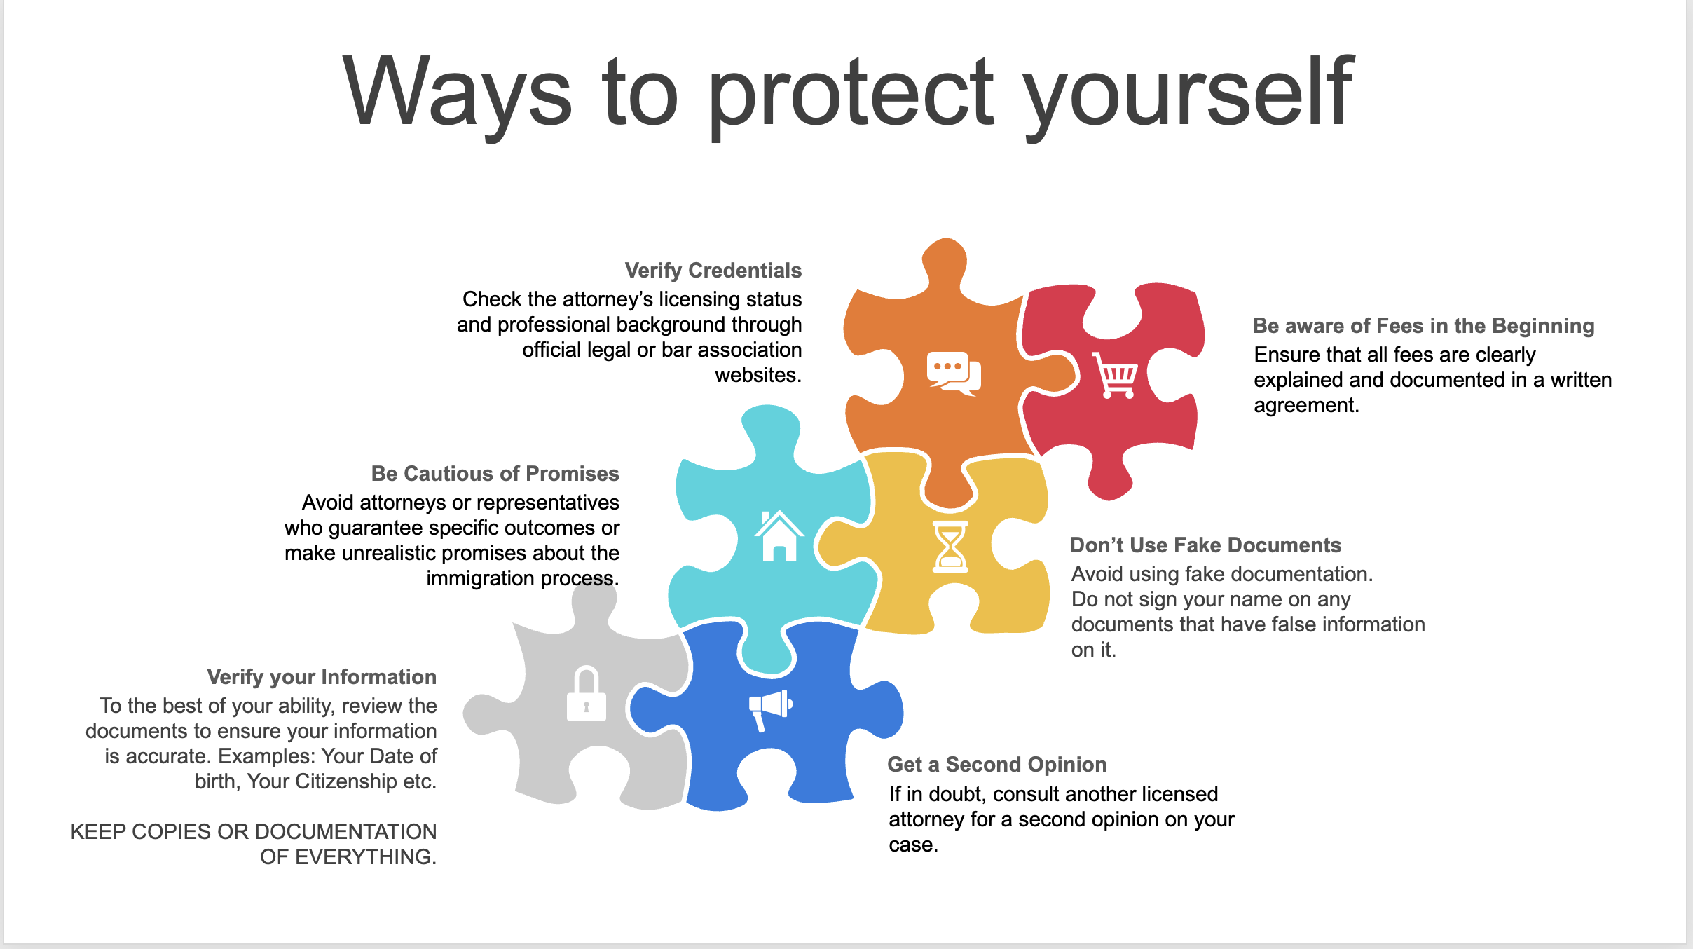

Slide 40
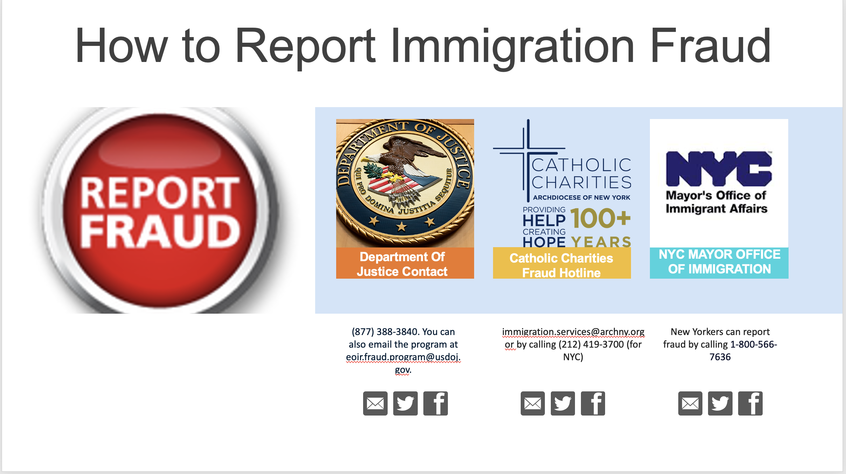

Slide 41

MENTAL HEALTH RESOURCES
Haitian Americans United for Progress (HAUP)
HAUP offers mental health counseling and support to the Haitian community in NYC with a focus on cultural sensitivity and language accessibility for Haitian Creole speakers.
Website: https://www.haupinc.org/
NYC Well
NYC Well provides free, confidential mental health support, crisis counseling, and substance abuse services. They offer interpretation services, including Haitian Creole, and are available 24/7.
Phone: 1-888-NYC-WELL (1-888-692-9355)
Website: NYC Well
Coalition for Haitian Empowerment (CHE)
CHE provides social services and mental health support to the Haitian community. Their programs focus on the unique mental health challenges faced by Haitian immigrants, such as trauma from migration and acculturation stress.
Website: https://www.coalitionforhaitianempowerment.org/
Apicha Community Health Center
Apicha Community Health Center offers mental health services to immigrant and underserved communities, including Haitians. They provide culturally competent care with a focus on the immigrant experience and trauma-informed counseling.
Website: https://apicha.org/
This Photo by Unknown Author is licensed under CC BY-SA

Slide 42

Community & Advocacy Resources
Haitian Women for Haitian Refugees: Provides support for Haitian immigrants, including language classes, advocacy, and immigration assistance. (Located in Brooklyn)
  Website: Haitian Women for Haitian Refugees
Make the Road New York: An advocacy group for immigrant and working-class communities that offers education, legal services, and healthcare access. (Located in: Brooklyn, Queens, Long Island, Manhattan and Staten Island)
  Website: Make the Road New York

Slide 43

EDUCATIONAL RESOURCES
NYC Department of Education (DOE): Regardless of immigration status, all children in NYC have the right to attend public school. The DOE offers language support, special education services, and bilingual education programs for Haitian Creole-speaking students. (Located in Manhattan)
  Website: NYC https://www.schools.nyc.gov/
UnLocal: A nonprofit organization offering free legal support and educational workshops for immigrant families, with programs targeting Haitian families. (Located in Manhattan)
  Website: https://www.unlocal.org/
Haitian-American Community Coalition: HCC is an organization that is committed to providing supportive services for the central Brooklyn Community. (Located in Brooklyn)
  Website: https://www.hccinc.org/

Slide 44

FINANCIAL AID RESOURCES
TheDream.US: Offers scholarships for undocumented students (including Haitian students) in NYC who are not eligible for federal financial aid.
  Website: https://www.thedream.us/
New York State Tuition Assistance Program (TAP): Some undocumented students may qualify for state financial aid through programs like TAP.
  Website: NYS TAP
This Photo by Unknown Author is licensed under CC BY-SA

Slide 45
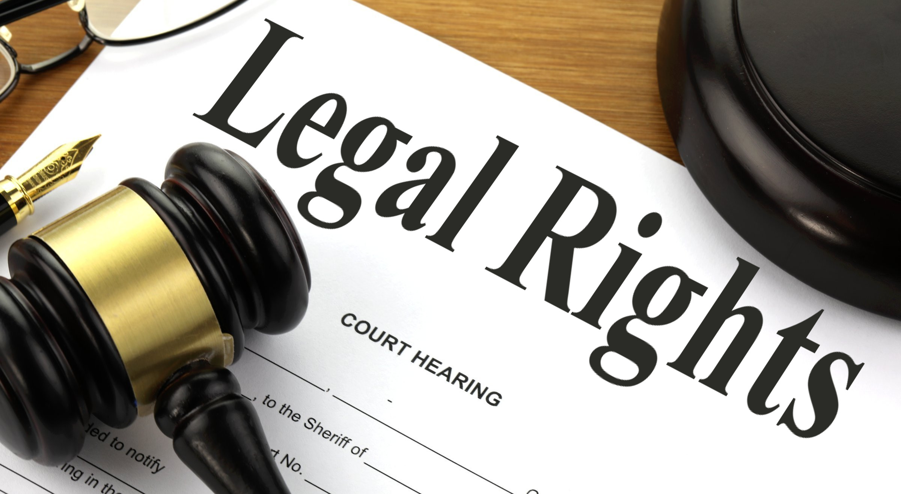
LEGAL RESOURCES
Haitian Americans United for Progress (HAUP): Offers legal assistance, immigration help, and community support to Haitian immigrants, including undocumented individuals. (Located in Queens)
Website: https://www.haupinc.org/
The New York Legal Assistance Group (NYLAG): Provides free civil legal services to low-income individuals, including Haitian immigrants. NYLAG can help with immigration status, education, and other civil matters. (Located in Manhattan)
Website: https://nylag.org/
The Legal Aid Society of NYC: Provides legal support for immigrants, including asylum, DACA, and TPS (Temporary Protected Status) applications. (Located in Manhattan)
Website: Legal https://www.legalaidnyc.org/ NYC
Catholic Charities Community Services: Provides emergency assistance, legal support, and immigrant services for Haitian families in NYC. (Located in Manhattan)
Website: https://catholiccharitiesny.org/
This Photo by Unknown Author is licensed under CC BY-SA

Slide 46
THANK YOU!

Slide 47





THANK YOU

