Slide 1
Site Monitoring Visit (SMV) Process
New York State 21st Century Community Learning Centers
2024
Dor Dourandi

Slide 2
Introduction
COMPLIANCE
Verify that programs are in compliance with Federal & State regulations and requirements
SHOWCASE
Provide an opportunity for programs to showcase their exceptional staff, students and families
QUALITY
Ensure that our programs are providing high quality services to students and families
IMPROVEMENT
Assess possible areas for improvement

Slide 3
Role of Technical Assistance Resource Centers (NYC TARC)
Responsibilities: In relation to the SMV process.
- Review SMV documents
- Conduct Targeted Technical Assistance (SMV PREP)
- Facilitate SMV visits
- Submit reports to NYSED
- Monitor and support action plans
- Provide Monthly check in (or as needed)
Notes:
Add pictures of the team

Slide 4
Role of Subgrantees
Responsibilities: In relation to the SMV process.
Create SMV Binder
Either Physical or digital
Organize and submit documentation
Work collaboratively with stakeholders
Develop action plans
Implement recommendations
Connect with your Evaluator
Check in with TARC about items on the action plan as they get completed.

Slide 5
Compliance Ratings
Compliance Definitions and Implications:
Full Compliance: All criteria met, meets guidelines.
Partial Compliance: Some criteria met, requires an action plan.
Non-Compliance: No criteria met, action needed.

Slide 6
Key Components of the SMV Process
Pre-Visit Preparation:
The TARC chooses a site
Document review and preparation
Scheduling and agenda setting
Day of Visit:
Document review session
Program walk-through and observations
On-site support and feedback
Post-Visit:
Final SMV report submission
Development and monitoring of action plans
Action plan items can be worked on for up to 6 months after the visit.
Notes:
"Treat everyday like an SMV day" Phil

Slide 7
Who needs to be at the visit
Evaluator
Sections G & H
Program Director
Sections A, B, D, E, F, G
Additional
Program Staff (Optional)
Ex: Site Coordinators, Data Managers, Ed Liaisons; site observations
Resource Center Staff
Facilitates visit
Fiscal Coordinator
Section C
NYSED Staff & School Admin
May attend at their discretion
Program Manager
Actively supports the Program Director

Slide 8
Explanation of Asterisks and (A) in the SMV Tool
Asterisks
Each asterisk has a specific meaning: *: This means **all programs** must provide the document. This means that the listed documentation must be provided by all subgrantees, regardless of the specific program type. **: This means **school district programs** must provide the document This documentation applies only to programs operated by school districts or those that fall under specific district regulations. ***:This is for programs that need School-Age Childcare (SACC) registration
.These documents are specifically required for programs registered under SACC regulations, which cover childcare programs.
(A)
The letter (A) means the document is required for "each site" in the program. If a program has more than one location, every location must provide that document.
Notes:
In the Site Monitoring Visit (SMV) Tool, asterisks (*, **, ***) indicate the type of required documentation.

Slide 9
Examples
A-3(a): Safety Supply Inventory records (*)
- This means that **Safety Supply Inventory records** are required for all programs.
A-4(a): Shelter-in-place records(*)
- This means that **Shelter-in-place records** must be provided for all sites.

Slide 10
Section A: Environment and Climate

Slide 11
Documents
A-3: Safety Supplies
- Documents Needed:
- Safety supply inventory records.
A-4: Safety Drills
- Documents Needed:
- Shelter-in-place records.
- Evacuation drill records.
- Lockdown drill records (if applicable).
- Evacuation and lockdown drill records
for summer programming (if applicable).
A-5: Transition Procedures
- Documents Needed:
- Sign-in and sign-out sheets.
A-6: Enrollment Systems for Health Needs
- Documents Needed:
- Sample of completed enrollment forms.
- Incident log, medication administration record, or emergency care plan.
- Evidence of CPR and AED certification for staff.

Slide 12
1. Lockdown (Threat in the building):
After the announcement, students stay silent, out of sight.
Teachers lock doors, pull in students, cover windows, and remain silent.
First responders will signal when it's safe to resume.
2. Shelter-In (Danger outside the building):
Students stay inside; normal activities continue. Staff secure exits and await the "All Clear" announcement.
3. Evacuation: students and staff leave the building quickly and safely in case of an emergency, like a fire. Everyone follows planned routes to gather at a safe area outside.
Drill Explanation

Slide 13
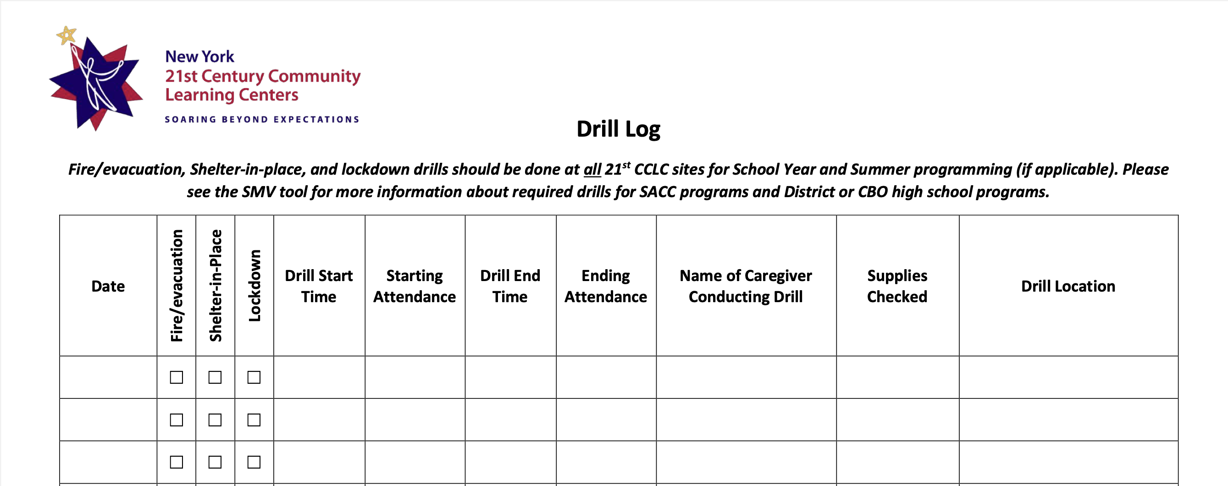

Slide 14
Reminder
If you are a SACC program, use your DOH drill log
If you are in a school district, follow their drill rules.

Slide 15
Observations
A-1: Supervision of Participants
- Observation: Reviewer observation of staff’s supervision practices.
- Observation: Reviewer observation of staff-student ratios maintained during each activity.
A-2: Security
- Observation: Reviewer observation of security practices, including sign-in/out procedures, visitor procedures, and designated entrances and exits.
A-3: Safety Supplies
- Observation: Reviewer observation of the accessibility of safety supplies and the visibility of alarms/exits.
A-5: Transition Procedures
- Observation: Reviewer observation of at least one of the following: participant arrivals or departures.
- Observation: Reviewer observation of a program activity transition.
A-7: Supportive Environment & Culture of Respect
- Observation: Reviewer observation of engagement and support provided to participants.
- Observation: Reviewer observation of respectful student-to-student and staff-to-student interactions.

Slide 16
Section B: Program Administration and Organization

Slide 17
•This section includes new requirements for recruitment strategies, EZReports data entry, certificates/licenses, and staff orientation.
• Key compliance: Staff schedules, safety procedures, and supervision policies must be site-specific.

Slide 18
B-1: Staff and Student Recruitment
Documents Needed
· Evidence of recruitment efforts (e.g., recruitment plan, meeting notes, correspondence, promotional materials).
· Written description of the hiring process and required experience for staff.
· Volunteer files (if applicable).
B-2: Scheduling
Documents Needed
· Program activity schedule(s).
B-3: EZReports Data Entry
Documents Needed
· EZReports reflecting activities with student enrolled, staffing, student IDs, attendance, program contacts, and staff roles (e.g., Grant Director, Program Director, Data Manager, Fiscal Agent).
· Print-out or screen capture of APR data checks (November, February, May, and early August for summer programming).
· Correspondence records between the Program Director and Data Manager (if applicable).

Slide 19
B-4: Certificates & Licenses
Documents Needed
· Certificate of Insurance.
· Certificate of Occupancy.
· SACC Registration (if applicable).
B-5: 21st CCLC Program Annual Staff Orientation
Documents Needed
· Agenda and attendance records for staff orientation.
· Staff orientation materials or resources (if applicable).
B-6: Staff Schedule
Documents Needed
· Staff schedule(s) showing days and hours of employment, along with staff titles/roles.
B-7: 21st CCLC Staff Handbook
Align the staff handbook to the indicators or ensure each topic covered is in the handbook (refer to tool
· Sample of signed acknowledgment page from staff.

Slide 20
How many asterisk are in this section?
Quick Trivia!

Slide 21
The answer is 19!!

Slide 22
Verbal Discussions
Section B (Program Administration/Organization):
1. B-1: Staff and Student Recruitment
- Verbal discussion of student selection protocol and program target population.
2. B-2: Scheduling - Verbal discussion regarding alignment of program activity schedule(s) and what is entered in EZReports.

Slide 23
Section C: Fiscal Administration/Organization

Slide 24
•This section includes updated cooperative budget management, personnel tracking, and inventory control system.
•Programs are required to submit fiscal forms on time, maintain inventory records, and follow new internal control and fraud detection procedures.

Slide 25
C-1: Cooperative Budget Management
Documents Needed
• Meeting records: Proof of cooperative budget discussions between program administration and the fiscal department.
Verbal Discussions
Discussion of the FS-25 submission (cash request to meet the immediate needs of the grant project).
C-2: Fiscal Records
Documents Needed
• Fiscal forms: FS-10 (submitted by May 15), FS-10-F (submitted by September 30), FS-10-A (submitted by April 15, if applicable).
• Sample of accounting system printouts: Showing program-specific financial records.
• Single audit record: Required if the program’s annual award exceeds $750,000.

Slide 26
C-3: Personnel Time and Effort Tracking System
Documents Needed
• Sample of time sheets: Evidence that staff time is accurately tracked.
• Sample of Personnel Activity Reports (PARs): Documents outlining time and effort allocation by staff members.
C-4: Inventory Control System
Documents Needed
• Inventory tracking record: Proof that equipment is properly tagged and recorded.

Slide 27
Section D: Staffing and Professional Development

Slide 28
D-1: 21st CCLC Conference Attendance
Documents Needed
· Attendance certificates for Fall and Spring conferences.
D-2: Assessment & Support of Staff
Documents Needed
· Completed staff observation forms (Program Activity Implementation Review or similar). Fall observation forms, Spring observation forms.
D-3: Collaborative Planning Time (CPT)
Documents Needed
· CPT agenda(s), notes, and attendance records.
D-4: Professional Development (PD) of Personnel
Documents Needed
· PD agenda(s) with learning objectives and attendance records.

Slide 29
Section E: Programming & Activities

Slide 30
Do you need to stretch?
Me too
:)

Slide 31
E: Programming & Activities
E-1: Support for Students of Special Populations
The program must provide reasonable accommodations for students with special needs.
Evidence to demonstrate compliance:
Supplies or equipment used to support these students.
Observations of how the program supports students of special populations.

Slide 32
E-2: Academic Enrichment and Additional Services
Activities must include academic enrichment and additional services promoting both academic and social-emotional development.
Examples include active learning methods such as:
Hands-on learning, experiential learning, project-based learning, and service learning.
Evidence to demonstrate compliance:
Lesson plans must include learning objectives, alignment with NYS Learning Standards, and Social Emotional Learning (SEL) benchmarks.
Observations and lesson plans must show academic enrichment and active learning.
Observations must show the effective delivery of these activities.

Slide 33
E-3: Culturally Responsive-Sustaining (CR-S) Education
Activities should be designed around student voice and choice and incorporate principles of CR-S education.
This includes:
Welcoming environments, high expectations, inclusive curriculum, and ongoing professional learning.
Evidence to demonstrate compliance:
Observations of staff using CR-S practices.
Lesson plans that adhere to CR-S education principles.
Family outreach materials that reflect CR-S education.
https://www.nysed.gov/crs/framework

Slide 34
E-5: Communication of Expectations to Students and Families
The program must clearly communicate participation expectations and family involvement opportunities.
Evidence to demonstrate compliance:
The 21st CCLC Student and Family Handbook must be shared with families within 30 days of the program's start.
Ongoing communication with families should be documented.

Slide 35
E-6: Adherence to Program’s Grant Proposal
The program’s activities should align with the goals and objectives outlined in the program’s grant proposal.
Evidence to demonstrate compliance:
Conversations about program modification requests if necessary.

Slide 36
Role of the Education Liaison in the 21st CCLC Program
Align the Program to the School Day:
Meet regularly with teachers and administrators to align 21st CCLC activities with school lessons and units by grade level.
Professional Development:
Provide workshops, coaching, and modeling for program staff, bringing expertise in instructional practices and youth development.
Review Activity Plans:
Collect, review, and provide feedback on activity and lesson plans to ensure alignment with learning and SEL standards and program goals.

Slide 37
Observe Activities and Provide Feedback:
Develop a schedule to observe activities and provide feedback on instructional practices and activity design.
Review and Analyze Data:
Support data analysis to identify trends in student successes and needs, informing program design and implementation.
Program Self-Assessment:
Collaborate with the Program Director, Site Coordinator, and other stakeholders to complete the Quality Self-Assessment (QSA) Tool, offering insights particularly related to Programming & Activities and Links to the School Day.
Support the Site Monitoring Visit:
Help the Program Director prepare documentation and contribute to the program walk-through, sharing observations on alignment with school initiatives and partners.

Slide 38
Section F: Establishes Strong Links to the School Day
F-1 Communication regarding alignment with school day programming and student progress
The Educational Liaison should communicate regularly with school staff to ensure the program aligns with school lessons and to stay informed about students' academic and behavioral progress.
Evidence to demonstrate compliance:
Correspondence records between the Educational Liaison and school staff (e.g., meeting agendas, minutes, planning notes).
Evidence that the program is aligned with the school day curriculum.
Notes:
Supporting Documentation:
(a) Evidence of Educational Liaison activity
(b) Evidence of programming aligned with school day curriculum
(c) Correspondence records demonstrating communication between education liaison and school or program (i.e., agendas, minutes, notes, etc.)

Slide 39
Section G: Participation, Engagement, & Partnerships
G-1: Surveying Students About Program Offerings
Programs must regularly seek input from students to align programming with their needs and interests.
Evidence to demonstrate compliance:
A sample of student interest surveys that show the results about program offerings.
Focus group protocols and notes documenting findings and recommendations for program design and activity offerings

Slide 40
G-2 Advisory Board Membership, Attendance, and Schedule
Advisory Board members must regularly attend meetings and actively participate.
Advisory Board meetings should be scheduled at least four times per year.
Evidence to demonstrate compliance:
A member roster including school administration, lead agency representation, partners, families, evaluators, and age-appropriate students.
Attendance records with names and roles of attendees.
A meeting schedule with dates for each quarterly meeting (July-Sept, Nov-Dec, Feb-Mar, May-June).
Advisory Board agendas and minutes from each meeting.

Slide 41
G-3: Gathering Family Members’ Input About Program Offerings
The program must regularly gather input from families to inform decision-making and planning.
Evidence to demonstrate compliance:
Parent/guardian/family surveys that gather input about program design and activity offerings.
A summary of findings from these surveys.
Notes:
(b) Attendance records including names of all attendees with title/roles
Advisory Board meetings are scheduled in advance and take place at least four times per year.

Slide 42
G-4 Needs Assessment
An annual needs assessment must be conducted at all sites to ensure the program aligns with the needs of the target population.
Evidence to demonstrate compliance:
The needs assessment should involve methods like household surveys, interviews, or focus groups to understand families’ needs and interests.
A summary of the findings from the needs assessment.
Note: This is not the same as a parent survey
Notes:
(a) Needs Assessment is administered to adult family members of participants (e.g., this could take the form of an inventory survey, individual interviews, focus group)
(b) Summary of Needs Assessment results/findings

Slide 43
G-5 Adult Learning Opportunities
The program should offer opportunities for families, such as family literacy, parenting skills, English as a Second Language (ESL), résumé building, financial literacy, and computer literacy.
Evidence to demonstrate compliance:
A schedule of family educational programming based on the needs assessment.
Attendance records from family events.
Resources or materials used for adult education sessions.
Notes:
301) 254-9453

Slide 44
Measuring Outcomes, Evaluation, and Program Sustainability
Joint Responsibility – Local Evaluator AND Program Administration
Program’s Responsibility regarding Evaluation

Slide 45
H-1 Evaluation Reports & Visits
H-1: Annual Evaluation Report
The program must submit an Annual Evaluation Report (AER) meeting all required elements based on the Local Evaluation Framework and Timeline.
Evidence to demonstrate compliance:
Proof of timely submission of the Annual Evaluation Report (due by September 30).
Evidence of two visits per site each program year, including observation notes, protocols used, and activities observed.
Evaluation Plan and Results Tables, measuring implementation and outcome indicators according to the awarded grant components.

Slide 46
H-2: Additional Evaluation Requirements
Ongoing communication between evaluators and stakeholders must take place, addressing both formative and summative findings to support program improvement.
Evidence to demonstrate compliance:
Evidence of improvement activities informed by AER recommendations.
Proof of timely submission of an Interim Evaluation Report (recommended February/March annually).
Correspondence records between the program director and evaluator.

Slide 47
H-3: Evaluability and Program Fidelity
The program should maintain fidelity to the original plan described in the NYSED-approved grant application and any program modifications.
Evidence to demonstrate compliance:
Evaluability checklist (for the first year of program operation).
Up-to-date and annually reviewed Program Logic Model (for Years 2-5).

Slide 48
H-4: Surveying Students' Satisfaction and Perception of Program Impact
The program must assess student satisfaction and the perceived impact of the program for all participants in grades 4 and above at each site.
Evidence to demonstrate compliance:
A sample of student surveys or other feedback methods (e.g., interviews, focus groups) that assess:
Satisfaction with the services provided (quality of implementation).
Perceived impact of the program (changes in attitudes, behavior, confidence, problem-solving, etc.).

Slide 49
Program’s Responsibility regarding Evaluation

Slide 50
H-5: Program Self-Assessment Tools
Programs must complete self-assessment tools (such as the Mid-Year Report and QSA Tool) twice a year for continuous improvement.
Evidence to demonstrate compliance:
Sample of completed QSAs (Fall and Spring).
Evidence of at least two meetings discussing QSA results.
QSA Action Plans or evidence of improvement activities informed by the QSA findings.
Mid-Year Report (due annually in February).

Slide 51
H-6 Communication of Evaluation Findings
Evaluation findings must be communicated to families and community stakeholders, ensuring the results are accessible and available to the public upon request.
Evidence to demonstrate compliance:
Evidence that the evaluation report or summaries are shared using at least one method (e.g., website, e-blasts, bulletin boards, media platforms, stakeholder meeting agendas).
Notes:
Check all that apply:
Program/district/school website
E-blasts
21st CCLC school/site bulletin board
Electronic distribution of brochure
Use of other media platforms
Stakeholder meeting agendas

Slide 52
H-7 Sustainability Plan
The program must have a preliminary or long-term plan for sustainability, including a multi-year funding plan with diversified funding sources.
Evidence to demonstrate compliance:
A written Sustainability Plan, including the date of the last annual update.
Verbal discussion of contingency efforts in case of turnover in key staff positions.
A list of current partners and service-providing vendors, summarizing their roles.
A list of prospective funding efforts and coordination with other federal, state, and local programs.
A list of prospective community assets or resources.

Slide 54
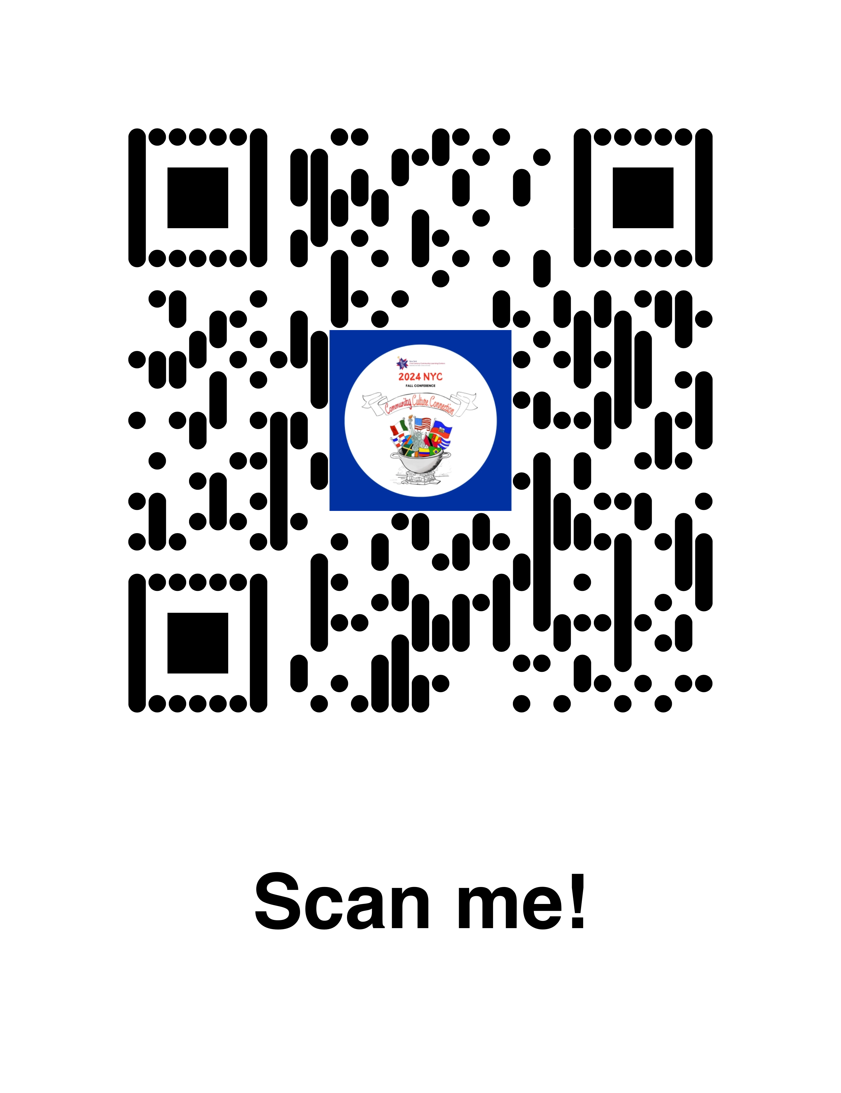
Q&A

