Slide 1
Stories of Collaboration and Strategies for Success
Purpose
To learn practical ideas and useful strategies for the 21C community from the experts who know, YOU!

Slide 2
North Syracuse Central School District
Rising Rox Stars
Operates at 2 sites – Roxboro Elementary School and Roxboro Middle School
Serves a diverse population of students
65% of students are economically disadvantaged
100% compliance per the SMV requirements
Student Showcases
Presenters:
Chau Ly (Program Director)
Kelly Masters (Evaluator)

Slide 3
Student Showcases
A Winning Family Engagement Strategy
Rising Rox Stars Program
North Syracuse Central School District

Slide 4
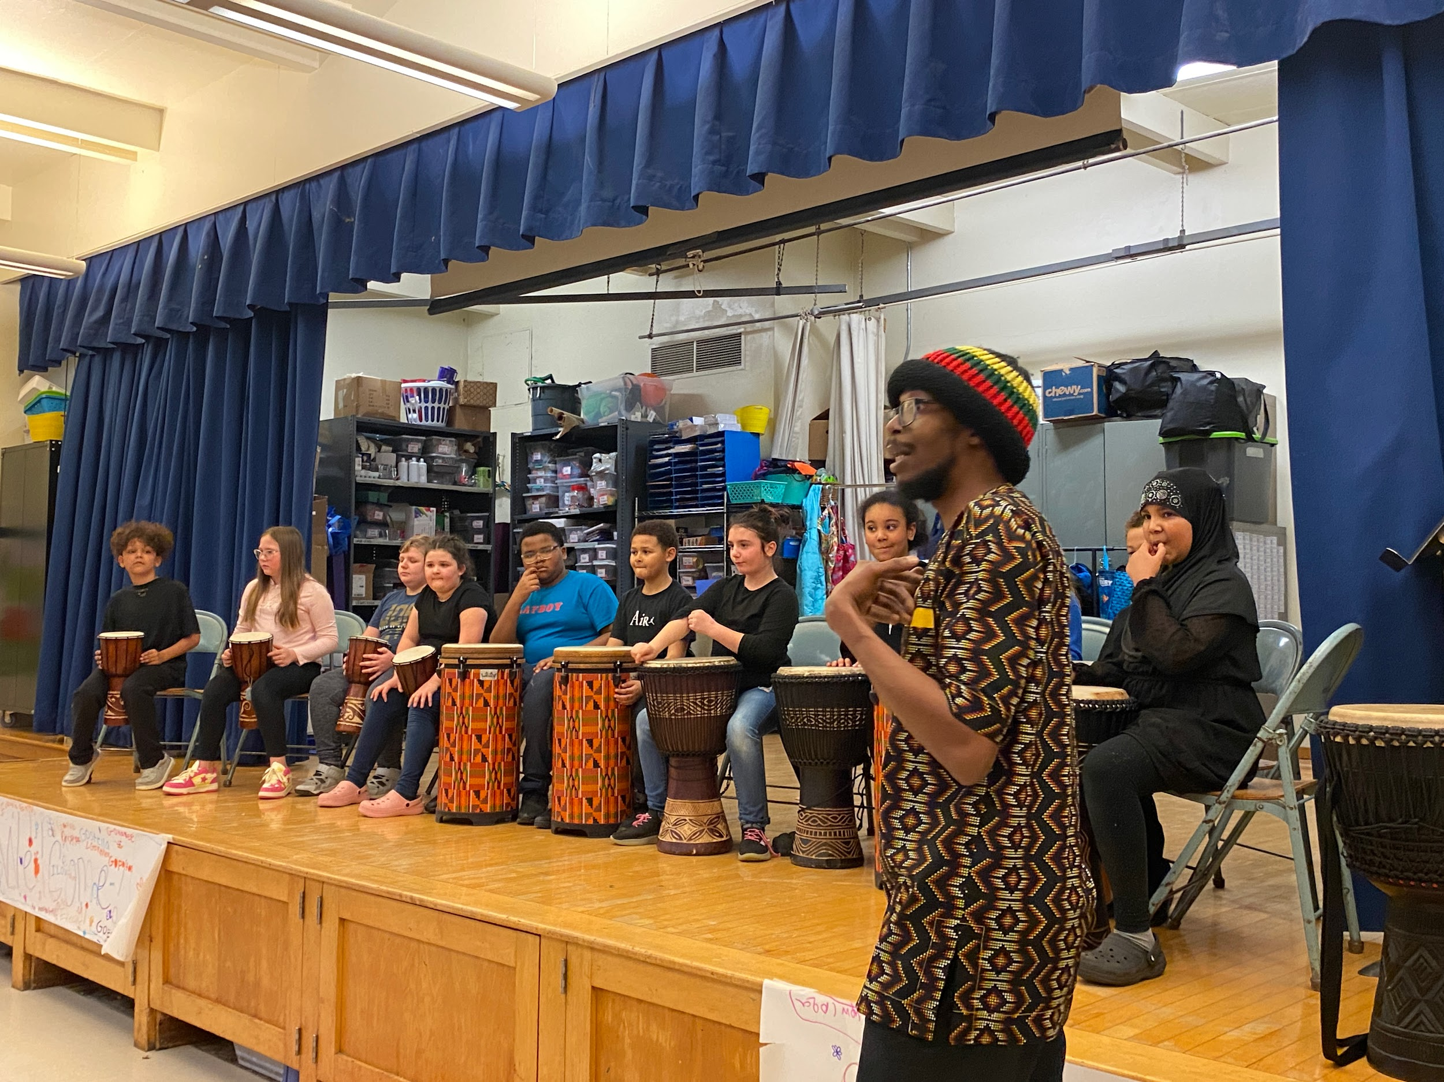
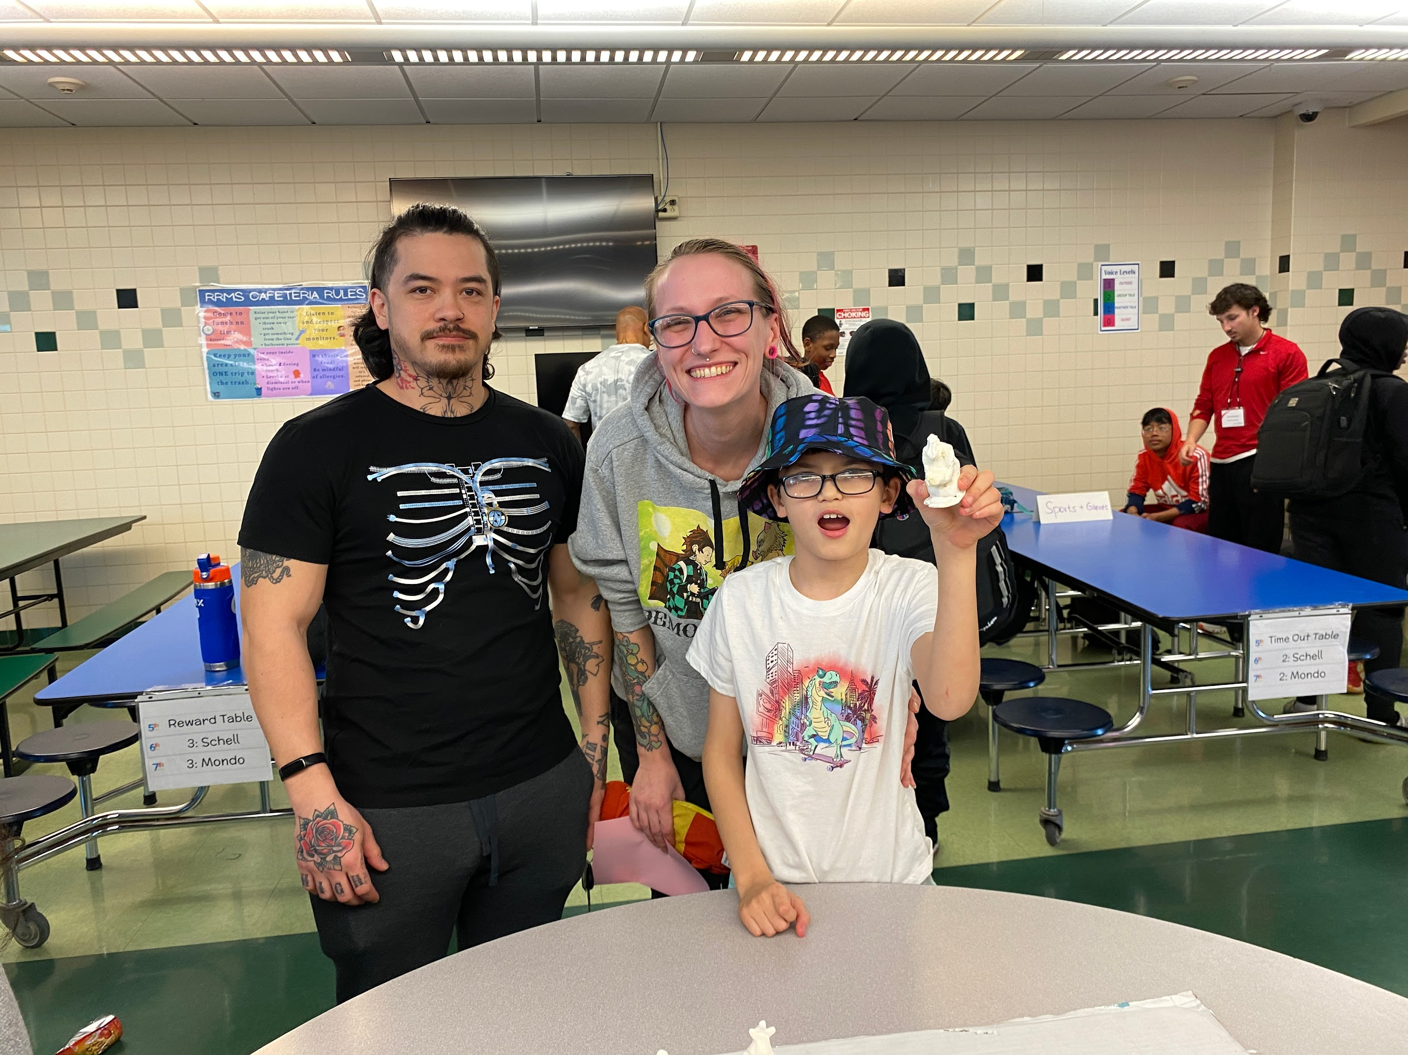
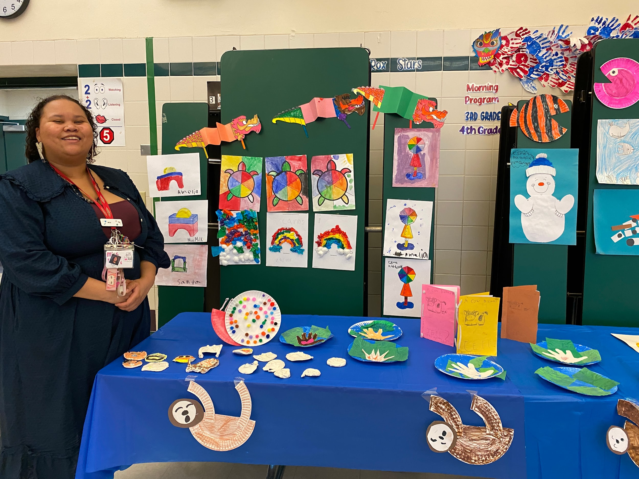
Student Showcases
Student displays of artwork, group projects and performances
Pride of students and families
Demonstrating value of 21st CCLC program

Slide 5
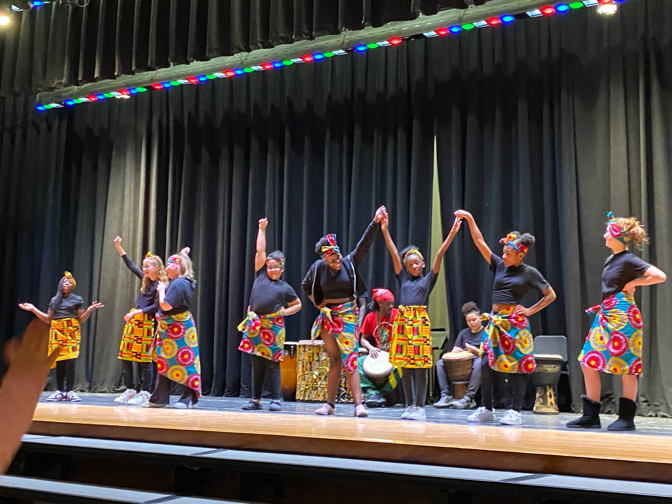
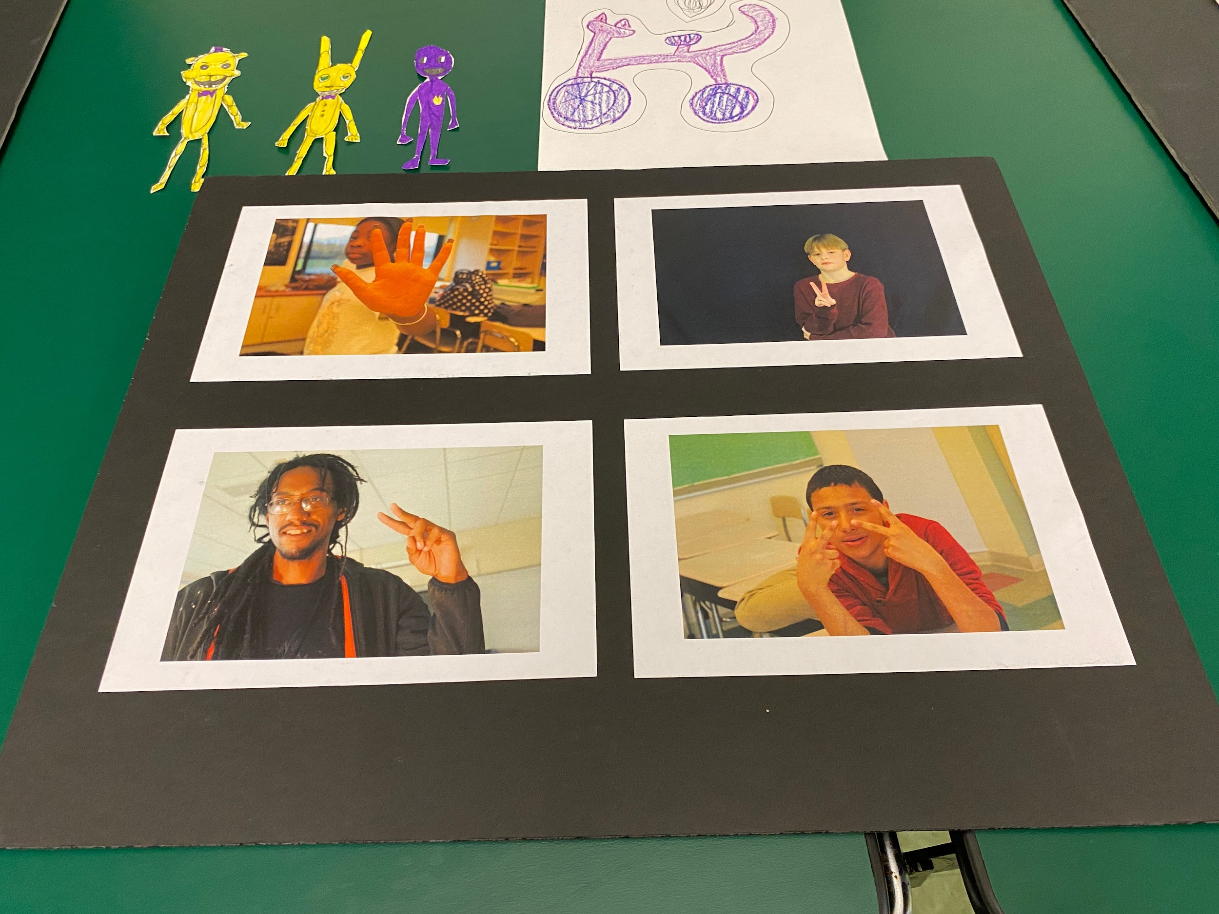
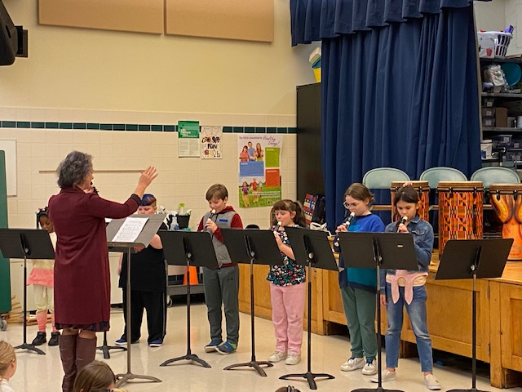
Evidence of Family Engagement
August Student Showcase: n=100 (33 RRE; 67 RRMS)
December Student Showcase: n=108 (64 RRE; 44 RRMS)
March Student Showcase: n=104 (61 RRE; 43 RRMS)
PI = 25% of parents will participate in 1 family engagement event annually.
n=286 parent attendees of 489 students (1+ hours) = 58% → PI Achieved

Slide 6
Saranac Lake Central School District
1,040 students served by the 21st CCLC grant
70% of students have participated in 21st CCLC programming
True collaboration between program and school administration – considered a “shared space”
Community Cafe
Presenters:
Kara Munn (Program Director)-absent
Erika Bezio (Data Manager)
Diane Fox (Superintendent)
Emily Hagstrom (Evaluator)

Slide 7
What’s a Community Café?
All café attendees answer the same question at the same time for a given time frame. At the end of the time, the discussion points are shared by a table member who was the designated note taker.
For the second and consecutive question rounds (typically 3 in total) the group changes tables to have a new set of ideas and thoughts shared. The note taker stays at their spot so the notes are consistent and in a similar fashion!
Community Cafés-
A facilitated group discussion focused on answering a set of questions that can guide your work by gathering the ideas of your group.

Slide 8
We are seeking ways to engage families at all grade levels; what family or student engagement opportunities would you like to see offered through our District? List as many ideas as possible that are K-12, elementary, middle school and high school geared.
Question 1
21st Century Community Learning Center funding provides opportunities to offer parent enrichment. What classes or events would you like to see offered? These opportunities would be for adults and can include educational and social activities. What would make these activities accessible for your attendance? (Childcare, hours, etc.)
Question 2
Question 3
What are the best parts of Saranac Lake
Central School District? Our school would reach the next level if it did/had/offered…?

Slide 9
Behind the scenes!
Get your school administrators to come to your café! They can support your work, guide tables who may start to go off topic (that never happens!) and provide insight when community members have questions.
Set the space:
We like to eat our “make your own” meal in our cafeteria for dinner and casual conversation. We then move to our library to host the actual café; a more formal setting for the ‘work’ component.
Develop your questions: What do you want to know? We want to know what families, kids and our community members WANT from 21st CCLC programming! Our staff (many of whom are parents of our students) share their ideas for what students have asked for. We also want to know WHO can deliver these programs? Is it our staff? A community vendor?
What we offer:
Dinner, discussion and celebration of the good already happening through the 21st CCLC initiatives.
Set the date and invite EVERYONE!
Reserve your space, get food service on board, send out invitations via your school’s mass communication system and get ready for an outstanding night.
What we could offer:
Childcare, staff pay and tokens of appreciation (school swag!)
2023-24 21st CCLC Programming - Google Slides

Slide 11
Fresh Youth Initiatives
Operating for 30 years
Approximately 80% of students have been in the United States for a year or less
Support low-income, immigrant, and first-generation youth
Community Engagement
Presenters:
Susan Gonzalez (Program Director)
Maeve Powlick (Evaluator)

Slide 13
Phipps Neighborhoods, Inc.
Fannie Lou Hamer M.S.
Social services organization based in the West Farms area of the Bronx
Impact the lives of over 5,000 youth and their families, yearly
A large percentage of the student population deal with food and clothing insecurity – most if not all of families are at or below the poverty line
Program Management
Presenters:
Jisbel Barada - Campus Director
Marcus Soler - Program Coordinator

Slide 14
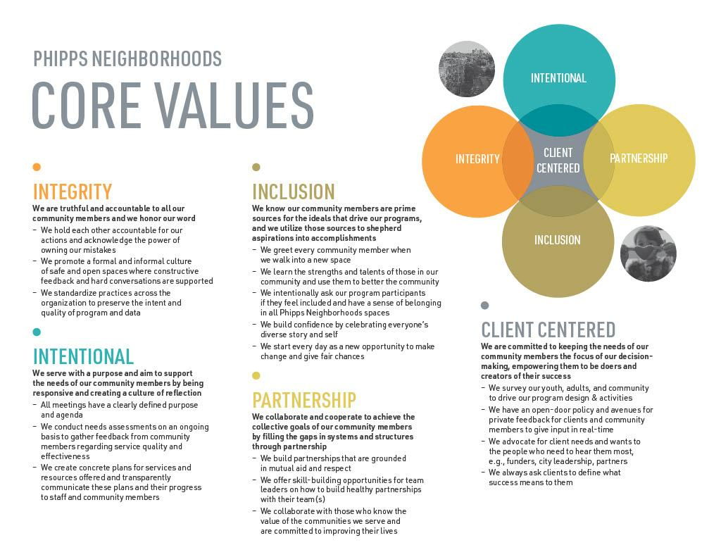
(Client Centered) Relationship Building ​
The most crucial part of our program model is relationship building. We try to make it a point for our student advocates to build relationships with students through our daily meet-and- greets. We also use Focus Groups to our advantage by surveying students to understand their desire and ideas for clubs, their needs outside school, and any general support.
​
We tried to shift the culture of the school by being consistent with our activities, celebrations, and partnerships with all stakeholders. We host monthly events celebrating mentee progress no matter how small as a component of Success Mentoring.​
Client Centered

Slide 15
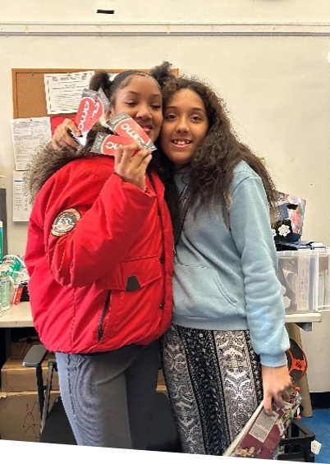
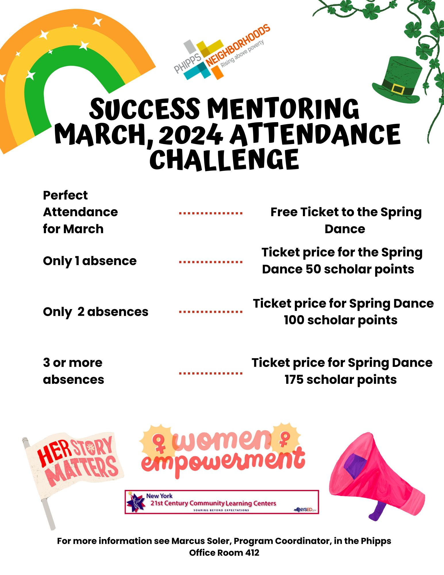
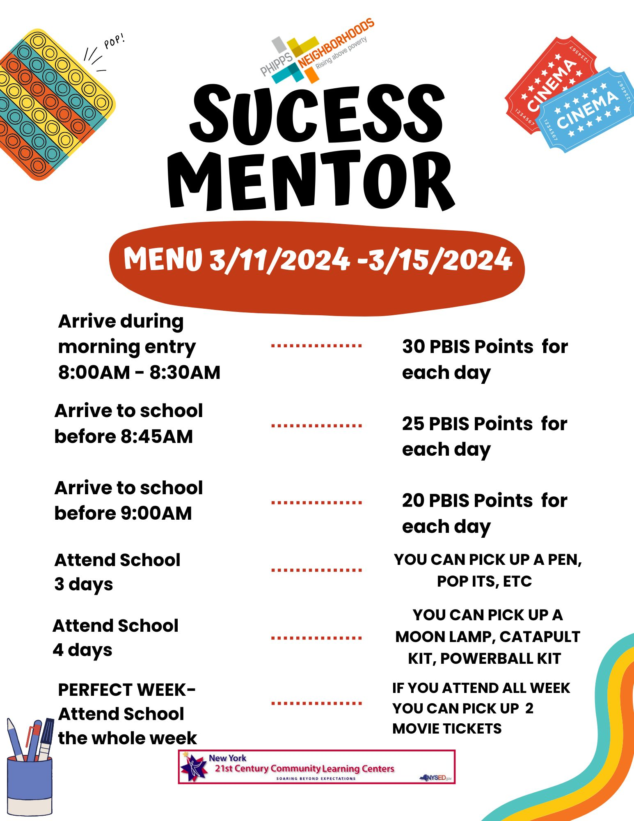
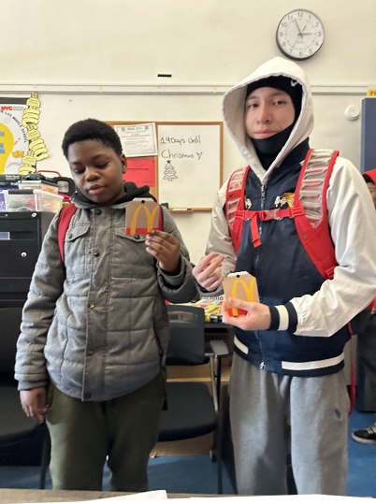
Our school had monthly celebrations for students with perfect attendance, however there were no celebrations for students in success mentoring. Thinking about how to make an inclusive program we made sure we created attendance challenges and celebrations for students in Success Mentoring. Students in this program take part in weekly and monthly challenges where they and their families are acknowledged for their progress and goal attainment. ​
Mentee Menu

Slide 16
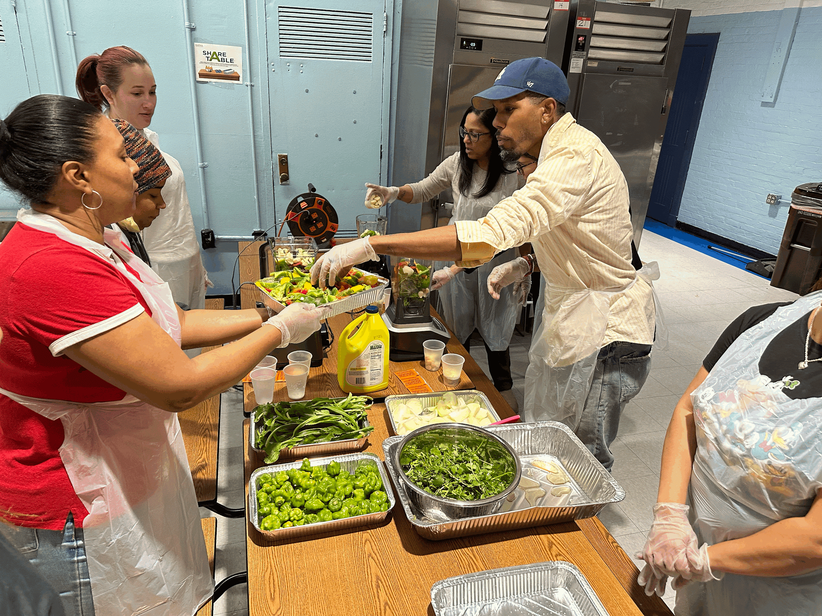
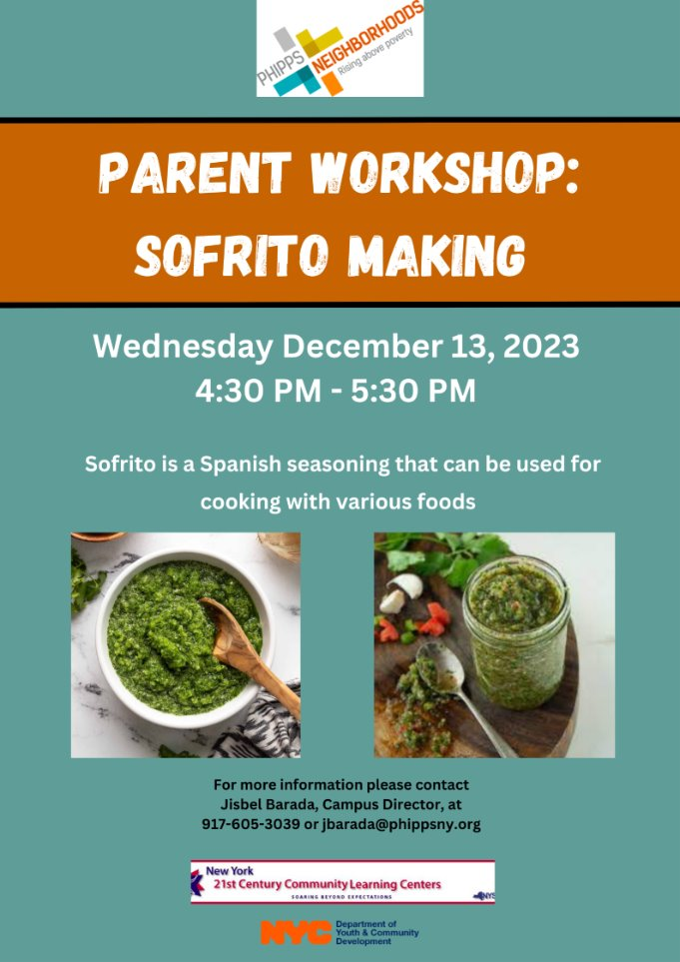
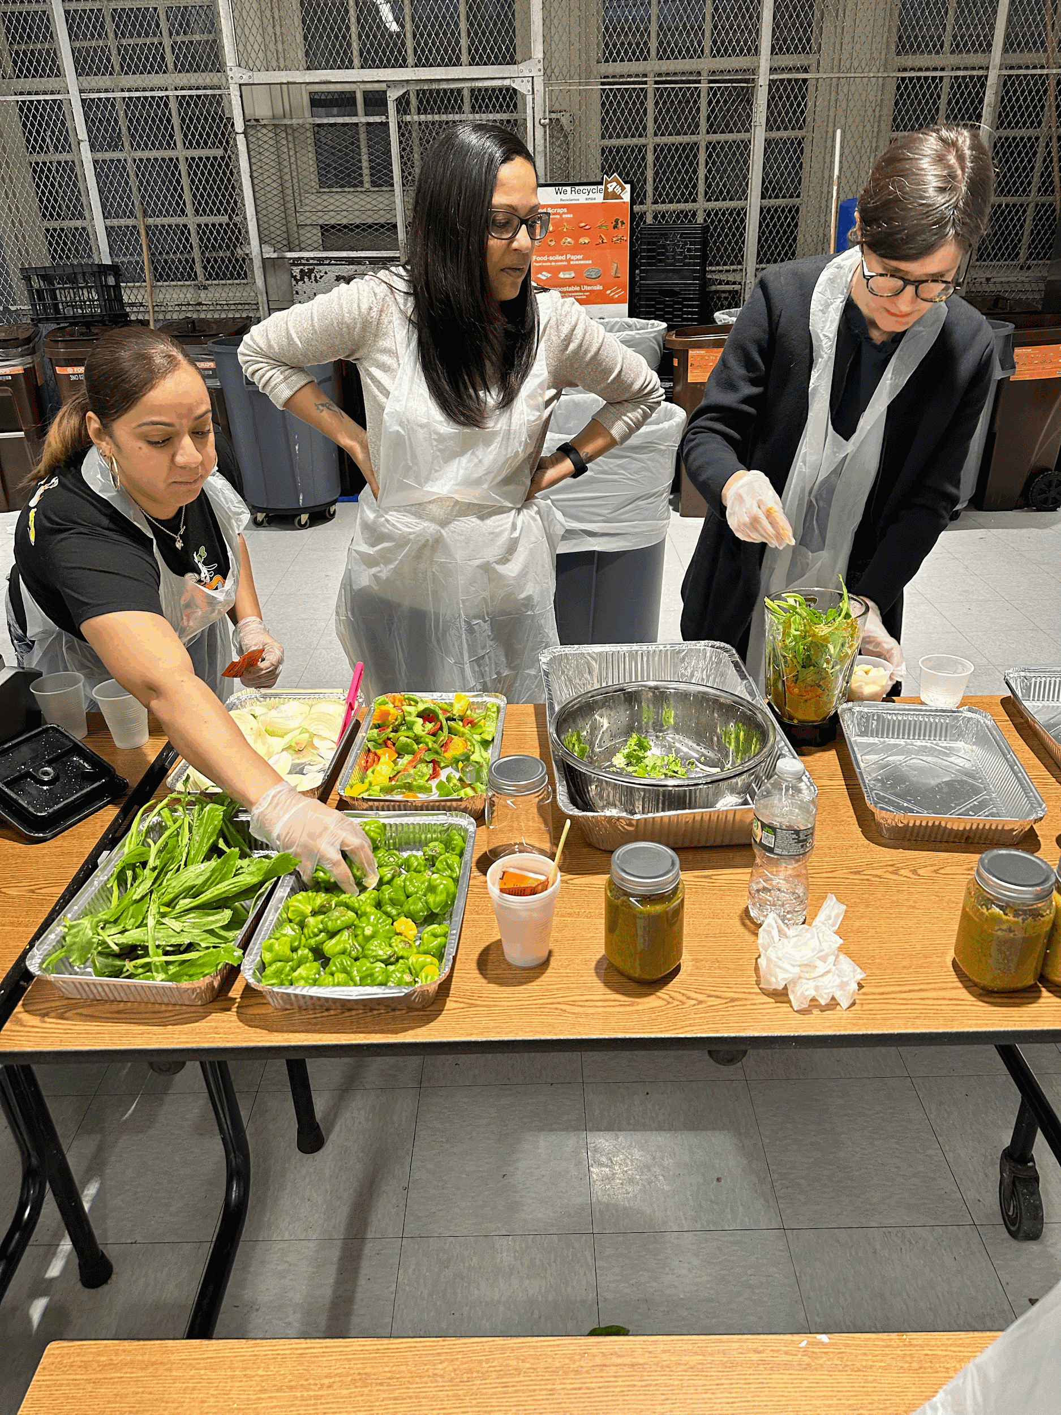
In alignment with our core values, we viewed Parent Engagement as Partnership. ​
We have taken parent engagement to a new level with our workshops. This year we held a Sofrito making class, had a SEL day for parents, and hosted a game night. ​
We also realized that part of relationship building was calling to thank our parent when their child should improvements. ​
Parent Engagement

Slide 17
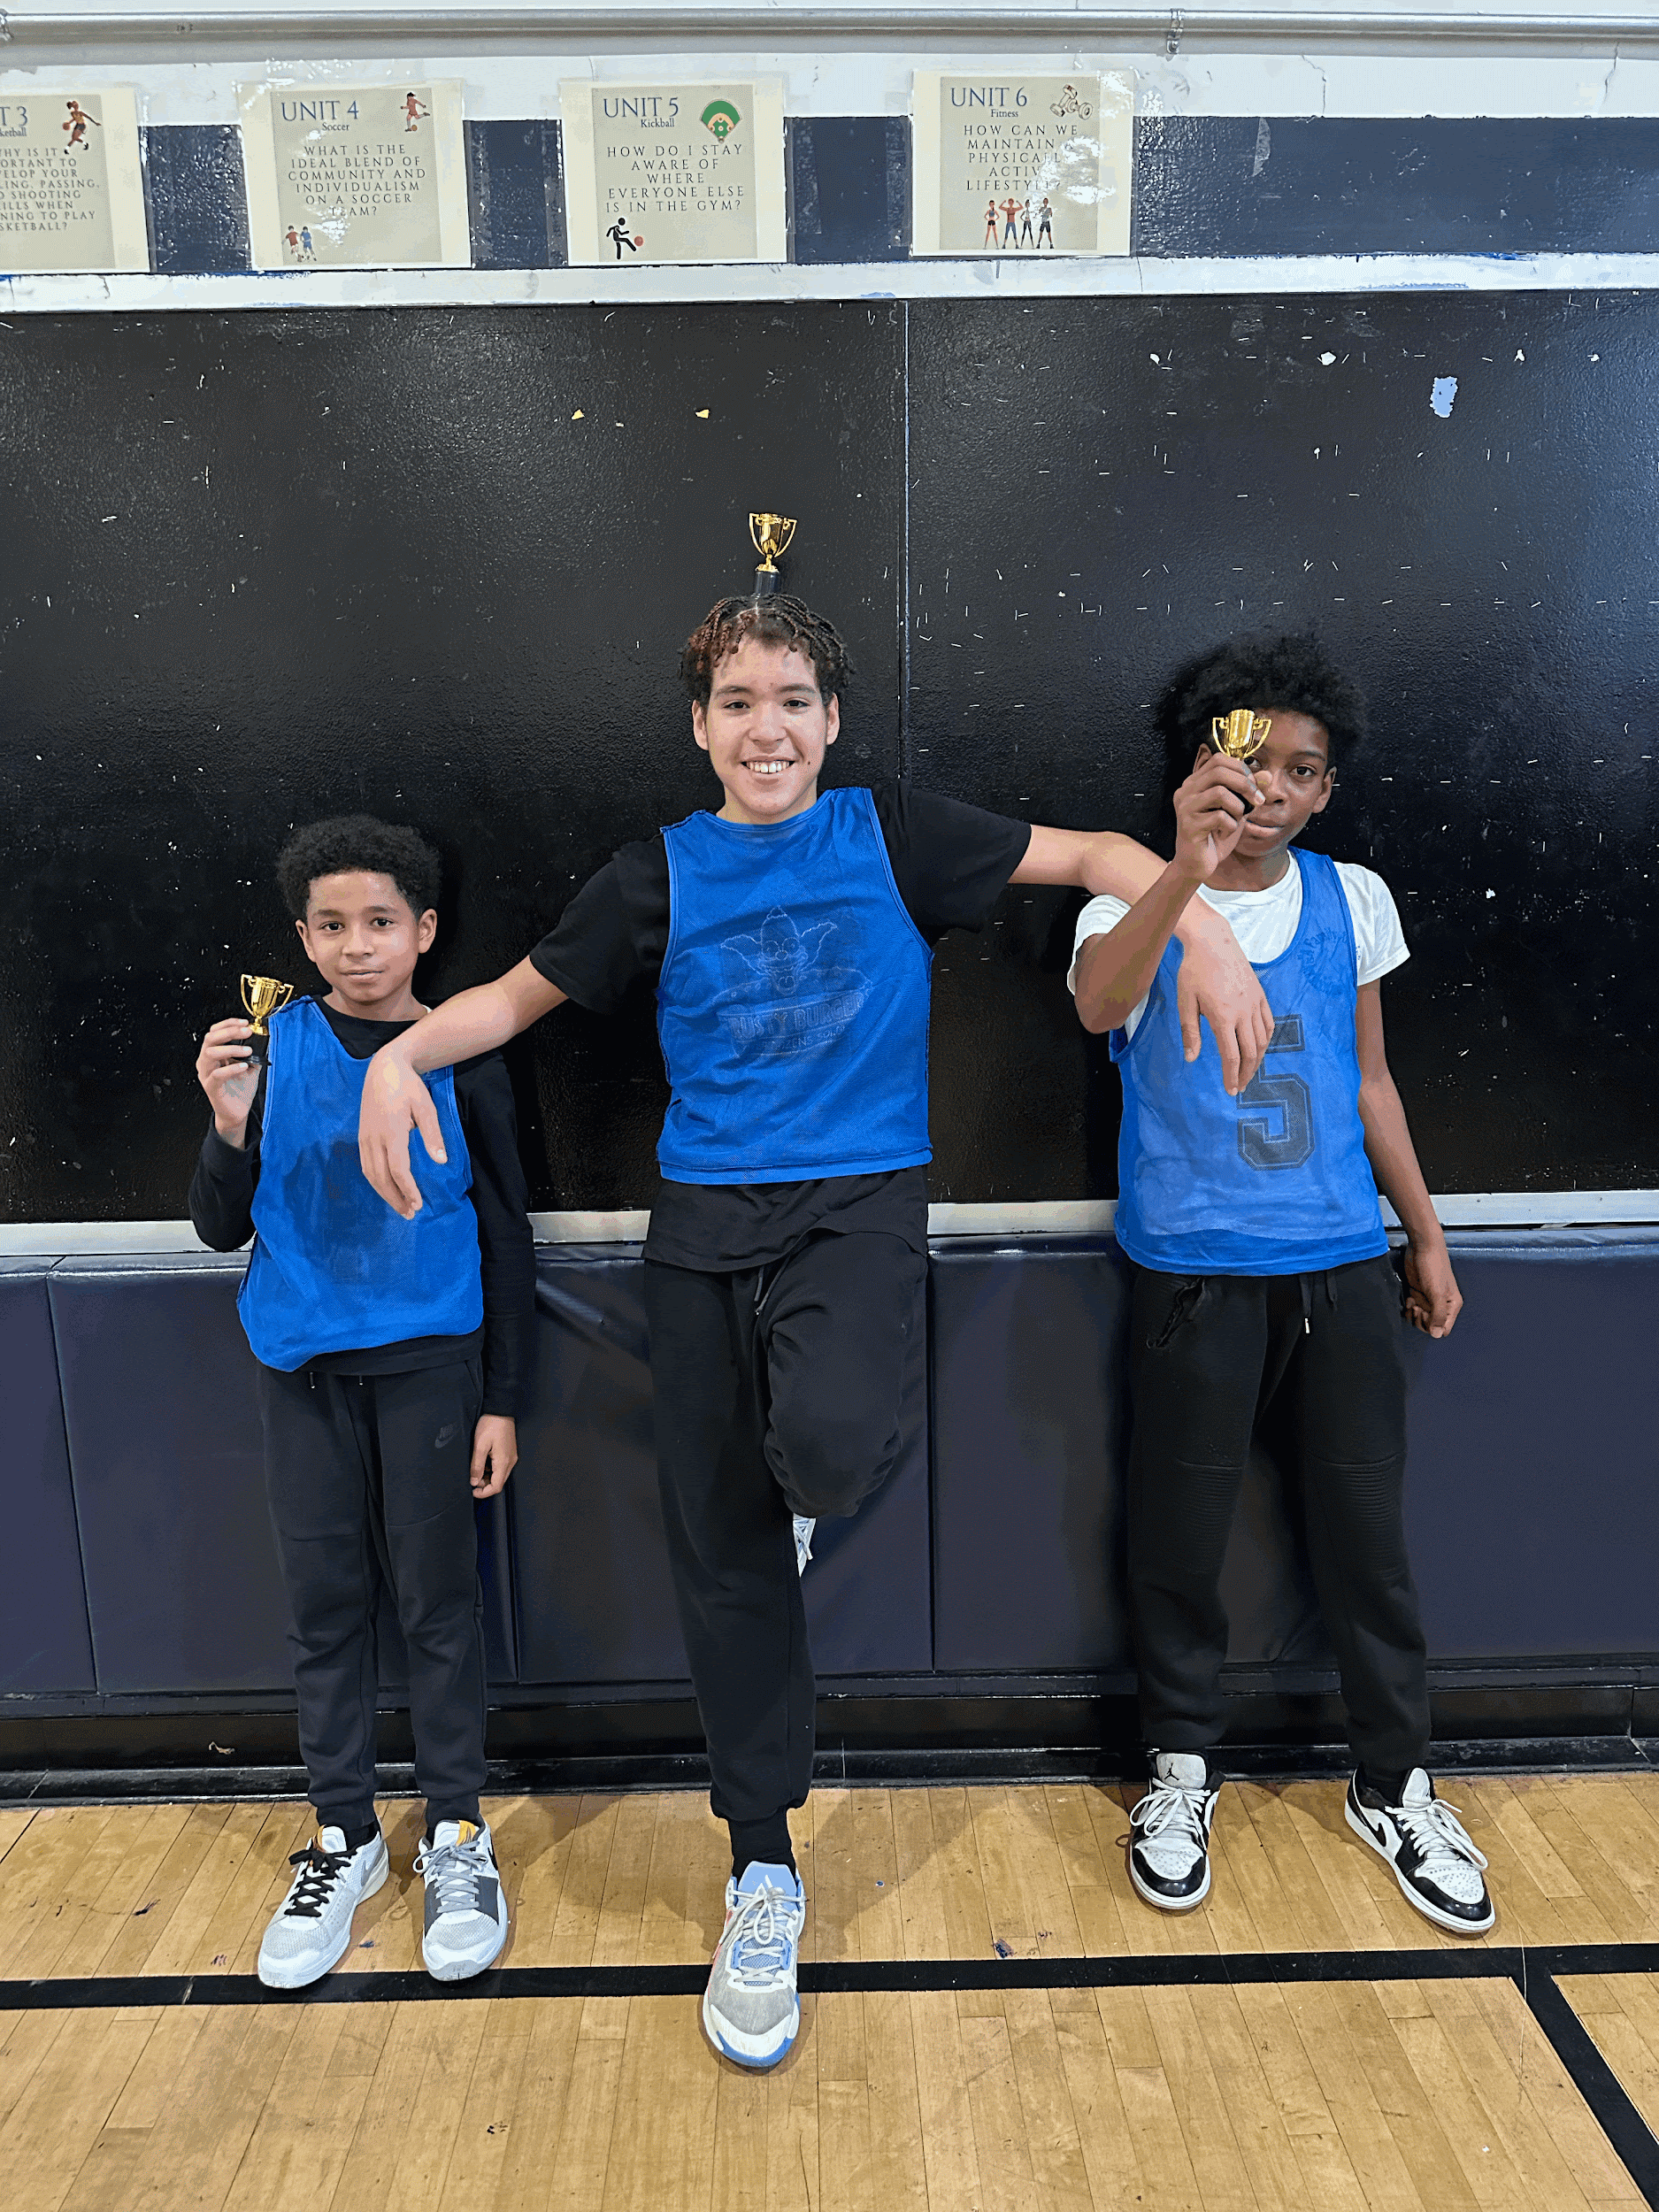
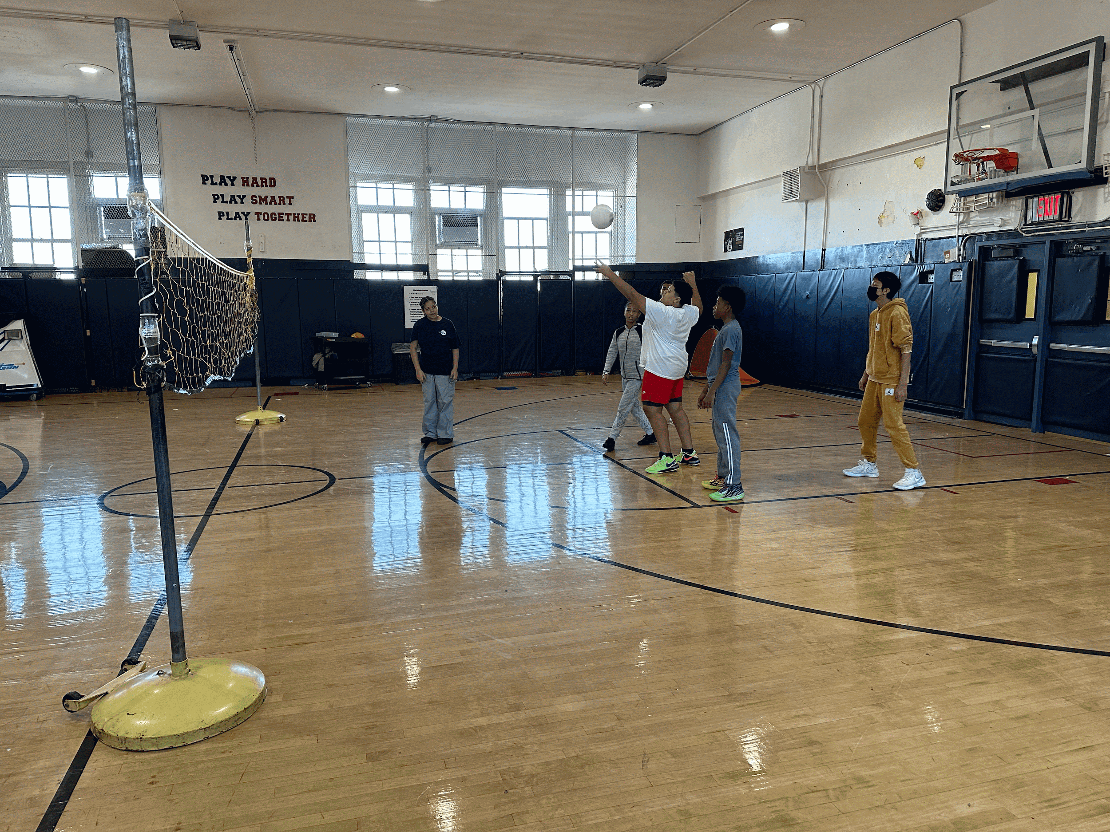
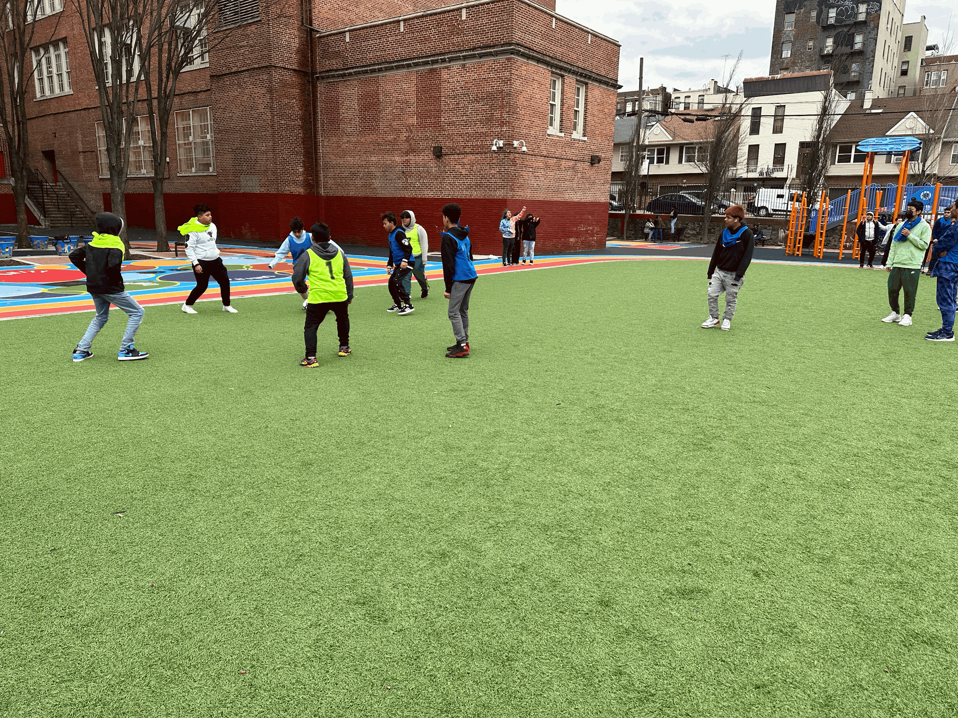
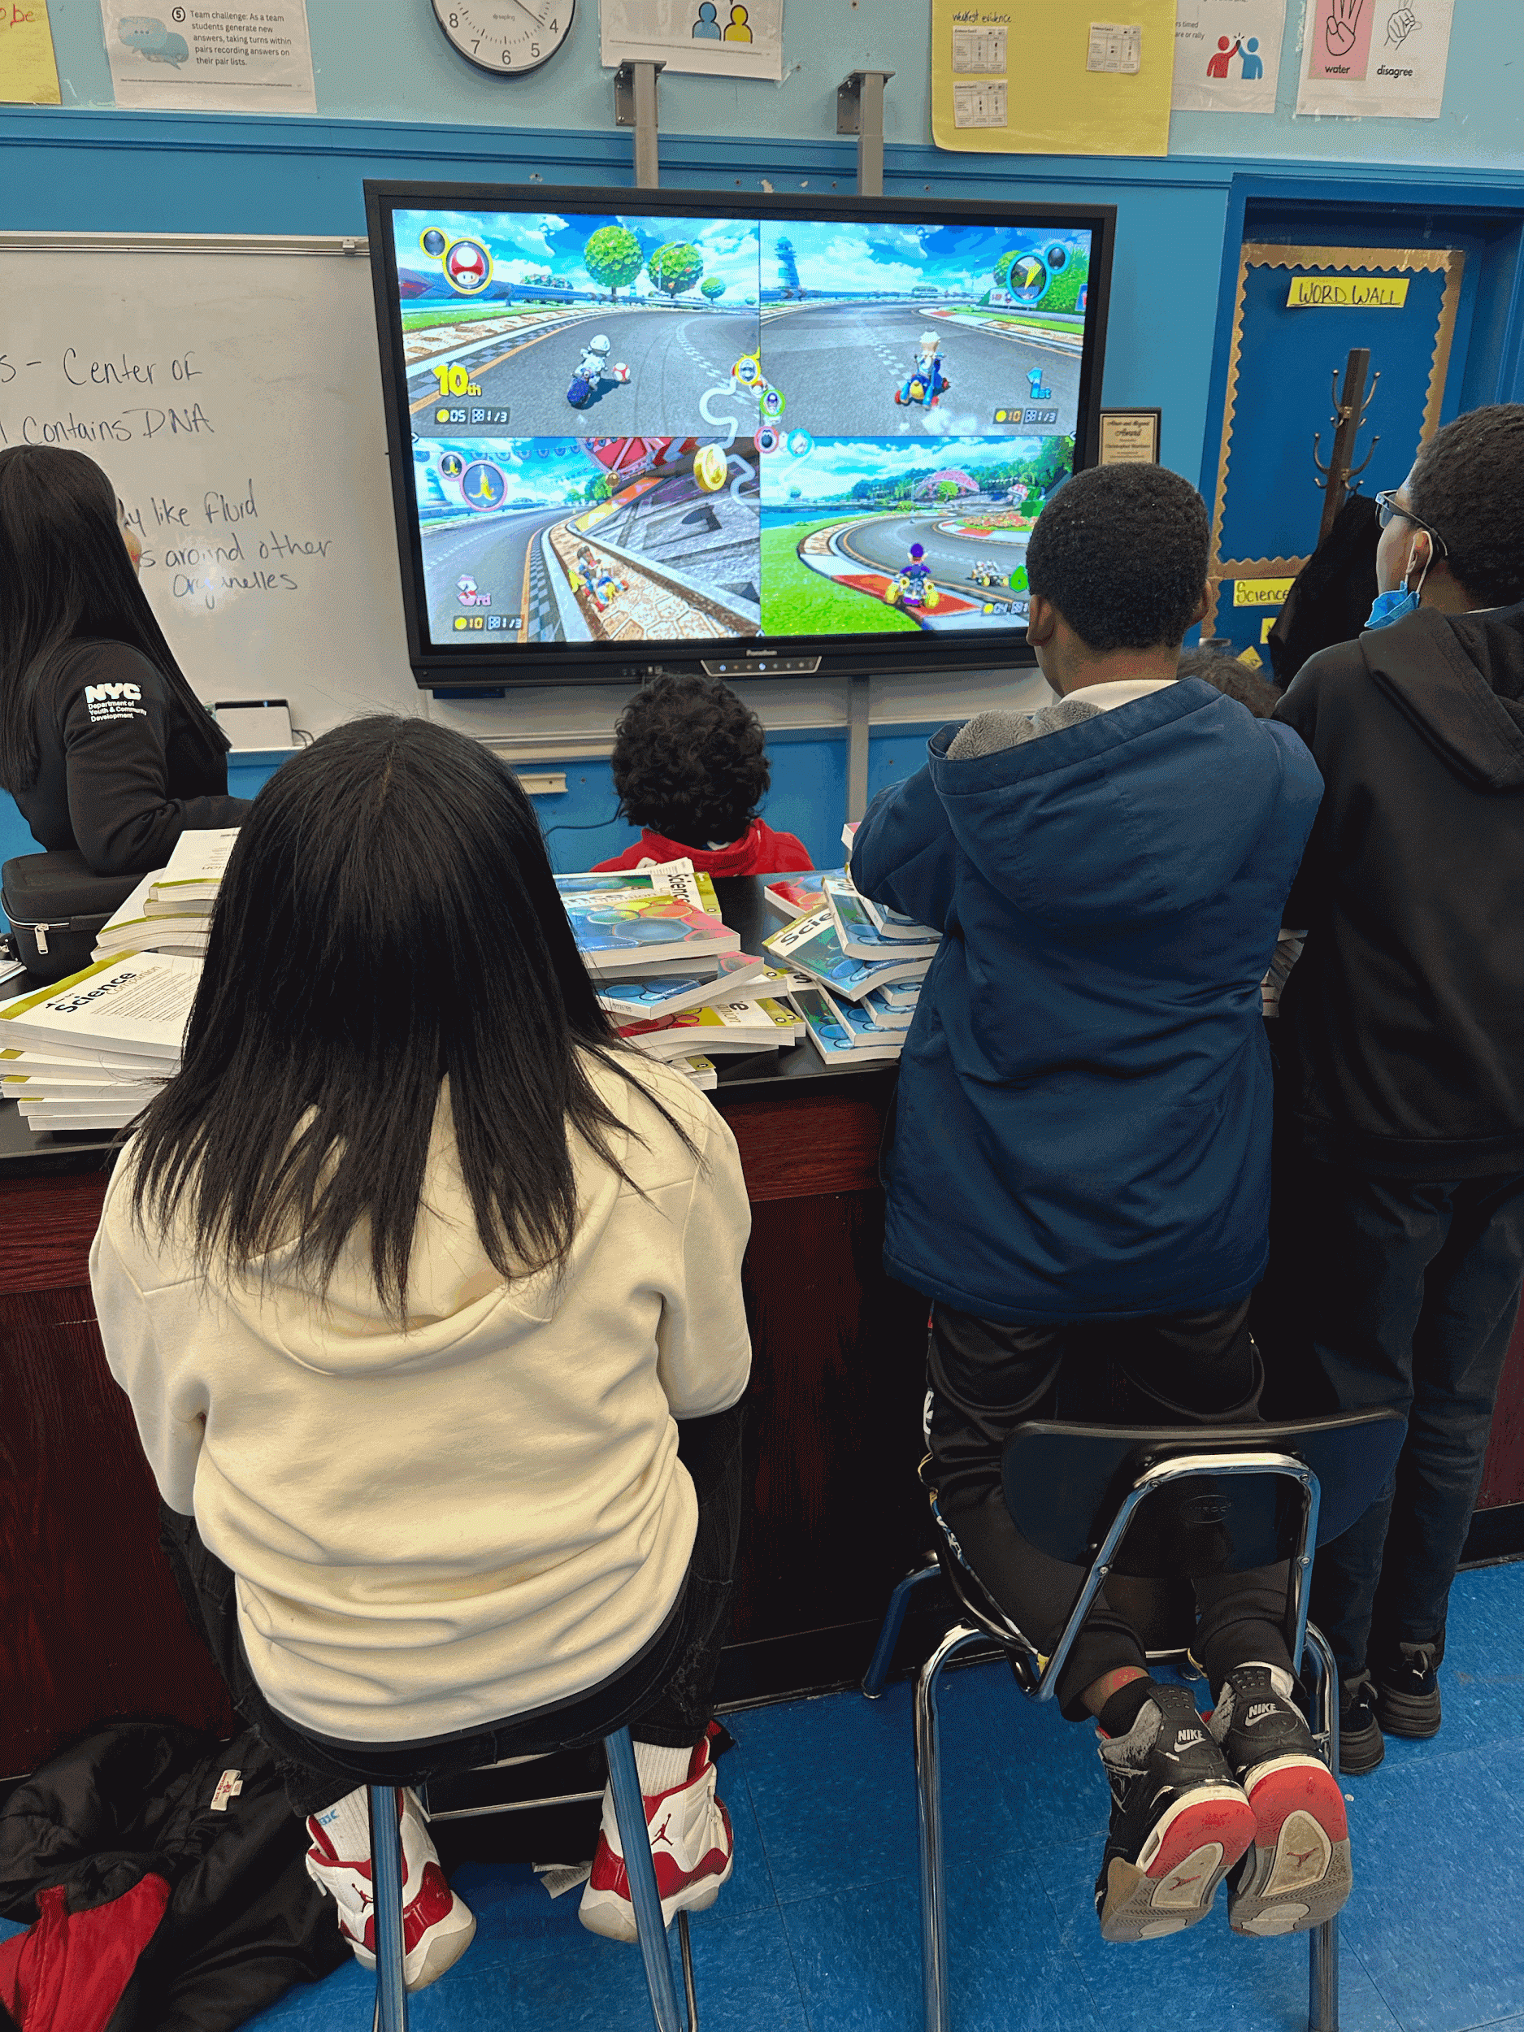
Tournaments
We owe a huge portion of our student engagement this year to our tournaments. It was something many of our students were asking for from the start of the year.
The Uno, Jenga, Soccer, Basketball, and more tournaments keeps our students engaged during their lunch hour.

