Slide 1
Meet Global Kids
Notes:
Diamond & JJ introduce self: Goal of the session: What's the our mission and how do we take it from paper to reality

Slide 2
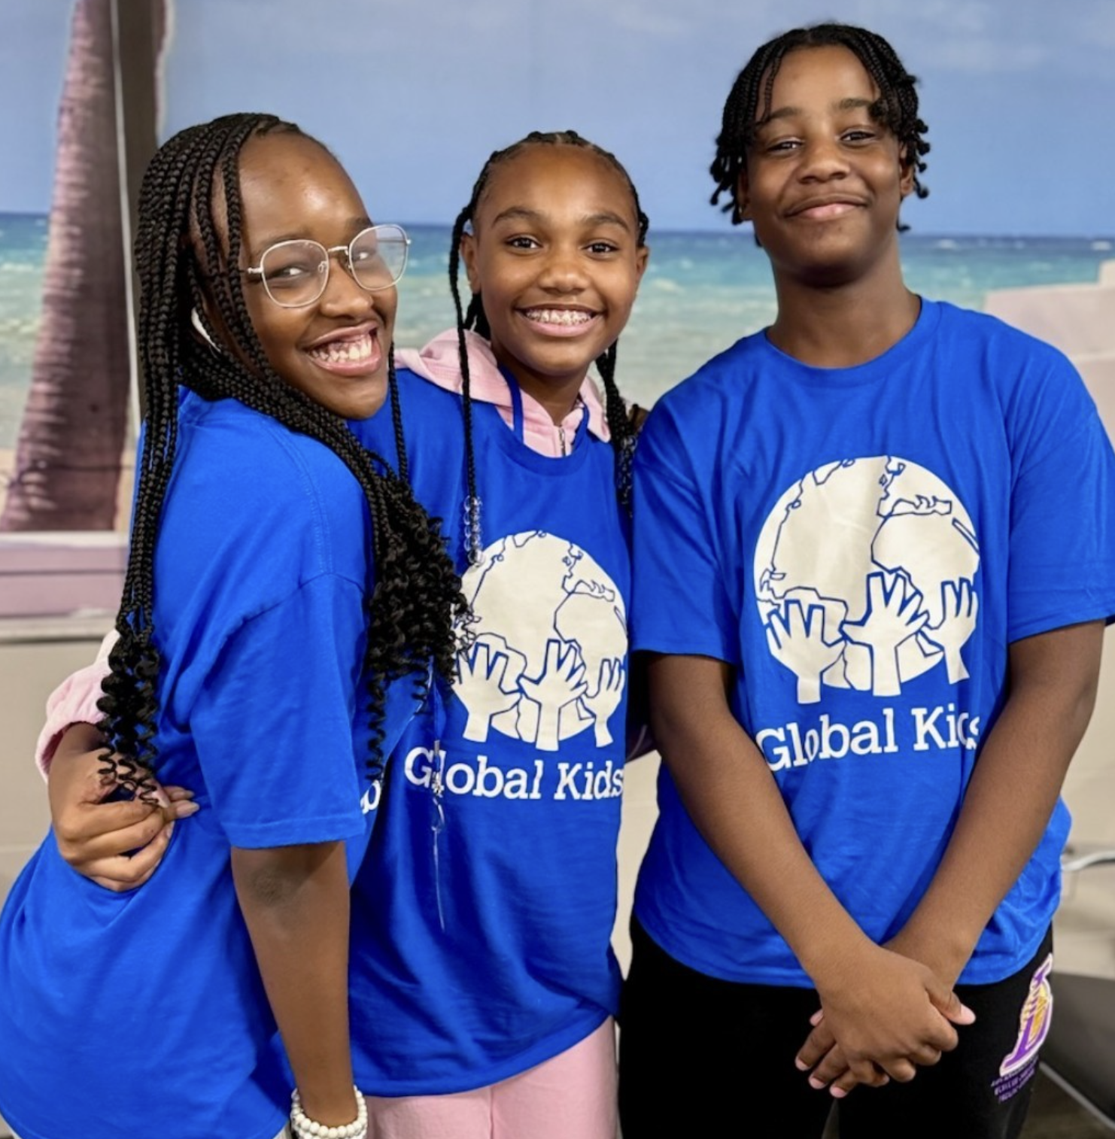
History, Work & Impact
Global Kids’ (GK) mission is to educate, inspire and mobilize youth to become global citizens who are positively engaged in the world and are prepared for their future.
Founded in 1989
Engaged over 250k young people in its programs in NYC & Washington DC
GK Programs Focus on 4 key pillars:
Academic Achievement
College & Career readiness
Social/Emotional Wellness
Global Citizenship
Notes:
1 person read the mission statement
Diamond/JJ goes over facts

Slide 3
How GK approaches the work
Youth Advisory Council
Made of mix of students from multiple schools
Meets at GK HQ
Student input
Survey design
Advocacy
Holiday Institutes (DOE Holiday programming)

Slide 4
How GK approaches the work: Ask Students!

Slide 5
Ask A High School-er!
Meet: Shaun E!
Notes:
What programs are you involved with at Global Kids?
What initially drew you to join GK?
In your perspective what is the biggest opportunity that folks have when working with high school students?
What's one thing you think adults should be asking high school students when it comes to out of school time activities?

