Slide 1
Fiscal Presentation and Q&A
Kyle McHugh
Dana Wagemaker
Gwyn Marschman
EMSC21stCCLC@nysed.gov
Notes:
Introductions + Change of Units
We are the Administrative Service and Accountability Unit, which is separate from 21st CCLC program staff.
We process *all grants* budgets and amendments.
We put both email addresses on the slides.

Slide 2
Agenda
Due Dates
Tips to Expedite Budget Approvals
Indirect Cost
Budget Reductions
Q&A
EMSC21stCCLC@nysed.gov
Notes:
Agenda for today:
Important due dates for 21st CCLC budgets
Tips for Expediting approvals
Indirect Cost
Some brief information about Budget Reductions
There will be time for Questions and Answers

Slide 3
Due Dates
Budget Amendments for Year 2 FS-10A, Updated Budget Narrative, Composite Budget, and MWBE Documents Submitted in Survey Monkey Apply. | April 15th, 2024
Budget Packet for Year 3 FS-10 Budget Narrative *NEW* Composite Budget MWBE Packet Send to EMSC21stCCLC@nysed.gov | May 15th, 2024
Final Expenditure Report for Year 2 FS-10F Send directly to Grants Finance | September 30th, 2024
Notes:
A memo was sent 4/8 to Program Directors and Fiscal Managers, alerting you to the fact that the due date for amendments has been moved to April 15th.
There were many requests for extensions and concerns about Spring changes. This change will be permanent; April 15th will be the new date for Amendments.
These get submitted into Survey Monkey Apply.
Upcoming is the Year 3 budgets due May 15th, less than a month away!
Programs will be required to submit a budget narrative with their budget. There will be more on that in 2 slides.
At the end of the summer, September 30th, the Final Expenditure Report (FS-10F) is due.
Please be mindful of the address you send things to. The FS-10F gets sent directly to the Office of Grants Finance. We all work in the same building, but when you mix up the addresses between our office, or Grants Finance, or the Contract Admin. Unit, they all go to very different places in the building. This wastes time.

Slide 4
Tips to Expedite Budget Approvals
FS-10
Excel is easier and faster!
Do not send the budget summary page until NYSED requests it
Project number
0187-24-8***
0187-25-8***
EMSC21stCCLC@nysed.gov
Notes:
To make your budget approval go faster, we recommend you use Excel when corresponding with us. It is much easier to edit an excel file than a pdf file. For us and you.
This screenshot is the top half of the budget summary page. The budget summary page is the last page of the FS-10, and it is the only part we will need sent to us from your FS-10.
The project costs must match the individual pages of the FS-10, and the grand total needs to be the exact award amount.
If you send it too early these numbers may have changed, and we will need a new original signature.
Therefore, do not need to send this page to us until we send an email approving your budget and requesting it. This was our biggest hold-up on most grants last year.
Another change to be aware of is that in year 3, the middle two numbers in your project number are updated to reflect the fiscal year. We all need to be checking these numbers.
When we started it was 23, we are currently in 24, and in Year 3 it will say 25.

Slide 5
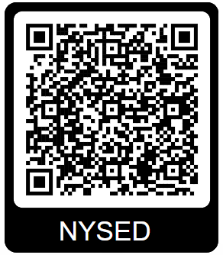
Tips to Expedite Budget Approvals
*New* Budget Narrative form required
Step 1: Create a budget narrative.
Step 2: Easily identify changes when you amend.
EMSC21stCCLC@nysed.gov
Notes:
Year 3 budgets will require a budget narrative, which you can find on the 21st CCLC fiscal page (QR code).
Why are we asking for this? And how will this benefit you?
Similar to the Budget Amendment Narrative, it will help align your budget and your program.
It will speed up our review process which will get your money where it needs to go faster.
We will not have to ask you questions about allowability or activities, schedules, or the purpose of expenditures if you explain it in the BN. (For example, “field trips” listed on FS-10, elaborate and give us the details in the BN).
We will not have to wait for communication to flow through us, subgrantees, Resource Centers, and program staff if you explain it in the BN.
The more descriptive and detailed you are, the better. This should not be a repeat of what is on your FS-10 or your FS-10A. It is a narrative that should support and expand upon your FS-10/FS-10A.
We are also asking that you describe how expenditures are
reasonable and necessary,
primarily targeted to the provision of direct services to students,
cost-effective and purposeful, and
used to support program goals and objectives.
In your budget narrative, we ask that you identify your key personnel specific to the 21st CCLC grant.
There has been a lot of mix-up in the past two years regarding how programs title personnel differently. For example, when we review budgets or when site-monitoring visits are being prepared for, we often see Director, Manager, and Coordinator used interchangeably. This will alleviate that confusion.
Lastly, you may be familiar with the BN through Survey Monkey Apply. For amendments you are required to update your BN, not just upload. We recommend using the BN you have and easily identifying changes when you amend, through track changes features, highlighting or underlining, etc. That will make our review faster.

Slide 6
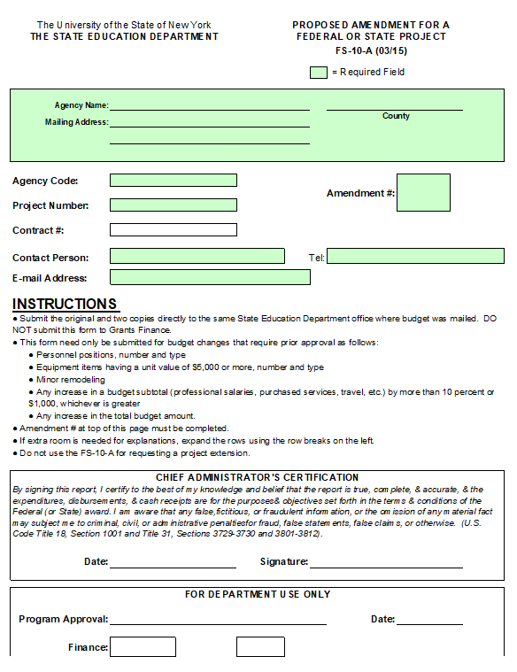
Tips to Expedite Budget Approvals
FS-10A
Excel is easier and faster!
Do not send the signed FS-10A until NYSED requests it.
Changes in vendors/partners may not need a budget amendment.
Program modifications are still needed.
MWBE forms may need to be modified.
EMSC21stCCLC@nysed.gov
Notes:
Similar to the FS-10, Excel will be faster for back-and-forth editing, and please do not send signatures until we ask.
Additionally, you may not need a BA if you are only changing vendors and partners.
The easiest example is when you have vendor A swapping for vendor B: no changes in money amounts, and the same activities.
If you aren’t sure, please ask!

Slide 7
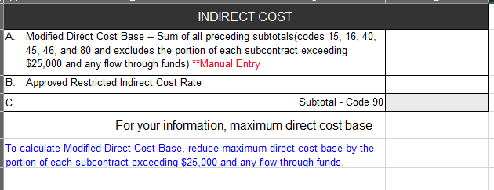
Indirect Cost
Indirect Cost is an Administrative cost.
10% cap on administrative costs in the Composite Budget
Recalculate your Indirect Cost when you do an amendment (even if you don’t touch that code, you might affect it).
EMSC21stCCLC@nysed.gov
Notes:
Indirect costs are costs of activities that benefit more than one program, not just 21st CCLC, and therefore they cannot be readily assigned to only one specific program. For example, a telephone that your whole building uses. 21st CCLC participants and staff can use it, but so can other grant programs. It’s different than a phone purchased specifically for 21st CCLC use.
Indirect Cost is an Administrative Cost, and 21st CCLC has a cap of 10% of the total budget on Admin costs.
Something to make your amendment go faster is recalculating your indirect cost when you do an amendment. Even if you don’t touch the code, your other proposed changes may affect its calculation.

Slide 8
Indirect Cost
Annual indirect cost rates (ICRs) are issued in the fall.
If your ICR for the new year is lower than what was used on your FS-10, Grants Finance will send a letter and remove money from that category (without replacing it elsewhere!).
Optional: Requesting an increase in ICR requires an FS-87-R (due January).
An FS-10 with the annual ICR must be processed first, and the increased ICR is done in an amendment.
EMSC21stCCLC@nysed.gov
Notes:
To put this into a timeline perspective, your budgets are due in May, but the annual indirect cost rates are issued in the fall.
If you have indirect costs in your budget, Dana and I and the MWBE office will process these no problem, however, Grants Finance will hold it until the new rates come out. This means your first 20% payment will be held up.
Additionally, if your ICR for the new year is lower than what was used on your FS-10, meaning you put too much money in that subtotal category, Grants Finance will send a letter to your organization and remove money from that category without replacing it elsewhere.
The Program Office and MWBE are unaware of this communication and budget change.
There is also the optional and rare request to increase the ICR, if for some reason a subgrantee has a need for more indirect costs. To do this requires an FS-10 to be processed with the annual ICR rate, an FS-87R to be submitted to Grants Finance, which can lock up that money until January or February, and then an FS-10A once the approval letter is sent from GF.

Slide 9
Indirect Cost: Example
Notes:
On the left is an example from a Purchased Services page of the FS-10. To calculate Indirect Cost it helps to write it like you’re doing your math homework.
Any vendor with a Proposed Expenditure of $25,000 or more gets capped at $25,000 to avoid money being used as a flow through.
Vendor A has $53,900, so we use $25k.
Vendor B is $25,000, we use 25k.
Vendor C is $6k, we use $6k.
Vendor D is $18k, we use $18k.
Vendor Evaluator is $120,000, we use $25k.
Then we add this together, which gives us $99,000.
On the right is a screenshot of the budget summary page, which shows us the subtotal costs.
To calculate the Modified Direct Cost Base, we add together all of the codes above Indirect Cost: 15, 16, 40, 45, 46, and 80. We use the $99,000 instead of the full amount for code 40.
This gives us $367,245, which we will bring to our Indirect Cost page.
Also note the categories that are not included – Boces services, minor remodeling, and equipment (49, 30, 20).

Slide 10
Indirect Cost: Example
EMSC21stCCLC@nysed.gov
Notes:
Once you add your MDCB and your ICR, the Indirect Cost can be calculated.

Slide 11
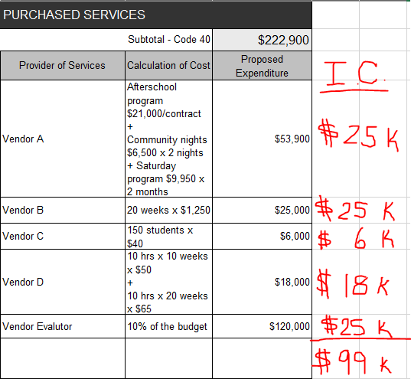
Indirect Cost - Amendments
Subtotal
Increase
Subtotal
Decrease
$48,900
$30,000
Notes:
Often times with an amendment people try to avoid touching indirect costs because of the calculation process. However, even if you are avoiding that category, your changes may impact the calculation.
In this example it is best case scenario. We want to swap $5,000 between two vendors and it won’t affect the IC calculation.
We’re removing $5,000 from Vendor A, and they stay at $25,000.
We’re adding $5,000 to Vendor B, and they also stay at $25,000.
This doesn’t affect the MDCB, so it doesn’t affect our IC calculation.

Slide 12
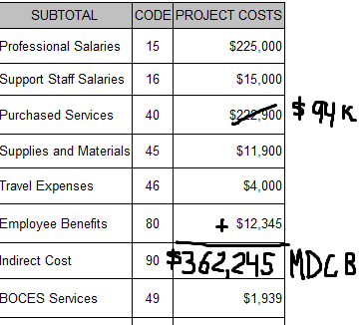
Indirect Cost - Amendments
Subtotal
Increase
Subtotal
Decrease
$58,900
$94k
$20,000
$20k
$362,245
$94k
Notes:
This example is more accurate to what we have seen. We want to swap $5,000 between two vendors and it is going to affect the IC.
We’re adding $5,000 to Vendor A, and their IC stays at $25,000.
However, now we’re removing $5,000 from Vendor B, so we will use $20,000 instead of the original $25,000.
This then affects the $99,000. It is now going to be $94,000. Bringing that over to our Budget Summary screenshot, we can now calculate the new MDCB, $362,245.

Slide 13
Indirect Cost: Example
$362,245.00
$9,780.62
EMSC21stCCLC@nysed.gov
Notes:
With our new MDCB, you can see how the Indirect Cost rate has changed.
We can see that before it was $9,916, and now it is calculating $9,780.62.
If your budget was perfect before, this change has now put you under your award amount, which is a problem, and you will have to go back in to fix it.

Slide 14
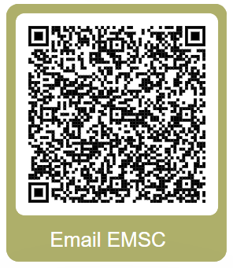
Budget Reductions
Memo sent on April 8, 2024 with details.
Attendance is due in EZReports July 15th, 2024.
Notifications to subgrantees that need a budget reduction will go out from program staff soon after.
Budget Reductions require an amendment (deadline TBD).
If we do not receive an amendment, NYSED will start by reducing Indirect Costs.
New Round 8A subgrantees (8136-8153) are not subject to budget reductions this year.
EMSC21stCCLC@nysed.gov
Notes:
A recent memo that was sent 4/8 to Program Directors and Fiscal Managers notified subgrantees that Budget Reductions will be occurring this year. If you did not receive this email, please see your program director or fiscal manager. If you are one of those people and you still didn’t receive it, please check-in with your Resource Center to update your contact information and reach out to the EMSC21stCCLC mailbox to get the information.
Attendance is due in EZReports July 15th, 2024. Subgrantees who need a budget reduction will receive a notification from program staff soon after.
Budget Reductions require an amendment. There will be a deadline for those amendments forthcoming from program staff. If we do not receive an amendment, NYSED will start by reducing indirect costs.
Subgrantees who are New Round 8A (8136-8153) are not subject to BRs this year.
For any questions about the budget reduction process, you can ask your Resource Center or program staff – Elizabeth, Princella, Nick, and Jolynn.
As always, email EMSC box.

Slide 15
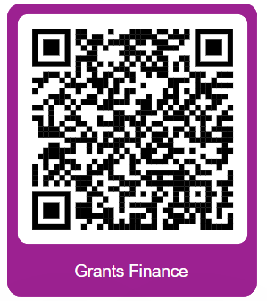
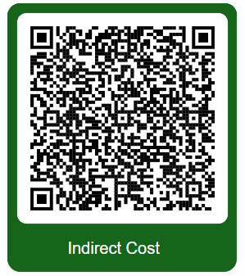
Q&A
EMSC21stCCLC@nysed.gov
Notes:
Black: NYSED 21st CCLC Fiscal page
Purple: Grants Finance Forms page
Green: Indirect Cost Calculation Tip Sheet

Slide 16
Participant Survey
Speed Session
Fiscal Presentation
& Q&A.
https://forms.gle/m1P2ZR3qNAHSMsWG9
Notes:
https://forms.gle/m1P2ZR3qNAHSMsWG9

