Slide 1
Rest of State
21st CCLC Technical Assistance Resource Center Presentation:
The QSA
Purpose
Discuss the Quality Self-Assessment Tool, its purpose and benefits, and how to implement it as a 21st CCLC program.

Slide 2
Agenda
Introductions
QSA Overview
Purpose of the QSA
How do you use the QSA?
Strategies for implementation
QSA Q&A

Slide 3
Rest of State Resource Center

Slide 4
What is quality?
What does quality mean to you and for your program?

Slide 5
QSA Overview: What is the QSA?
Designed to help programs assess, plan, and implement program improvements and achieve quality programming
Broken up into 10 elements, each with various indicators within these elements
Each Element addresses a different measure of quality:
Environment & Climate
Administration & Organization
Relationships
Staffing & Professional Development
Programming & Activities
Link to the School Day
Youth Engagement
Family & Community Partnerships
Program Sustainability & Growth
Measuring Outcomes/Evaluation

Slide 6
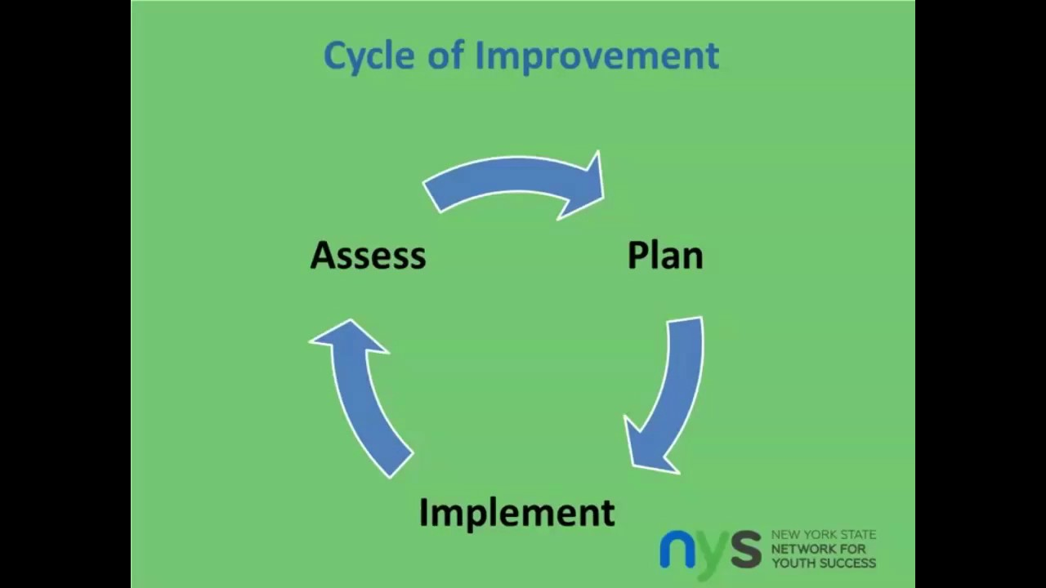
Why the QSA?
Cycle of Improvement…
The QSA is designed for continuous improvement, both proactive and responsive – it creates a cycle of assessing, planning, and implementing change
It breaks quality down to its parts
Administering it throughout the grant cycle allows for a full picture of the program and its improvement over time
Allows you to involve stakeholders

Slide 7
How do I use the QSA?
Ideally, the QSA should be administered twice a year – once in the fall, once in the spring is our suggestion
The QSA should involve all relevant stakeholders – it should not be an insular process, though it is an internal one
Staff
Local evaluator
School administrators
Age-appropriate students
Families
Community partners
Vendors

Slide 8
How can it be administered?
The QSA is designed to be an internal process that varies program to program
Each program should administer the QSA according to what makes sense for them – what will work for your program?
Work with your evaluator – they’ve completed this process before, and often have many strategies of their own to help you through each part of the process
Reach out for help with your individual circumstances

Slide 9
Break it into steps!
Step 1: Plan
Step 2: Administer
Step 3: Implement

Slide 10
Step 1: Plan
Does it make sense to administer the QSA twice a year? If so, when will you do so?
Who will be responsible for planning for and administering the QSA? Who will be involved in the process?
Do you want to tackle ALL elements at the same time? Focus on 2-3 elements? Break it down by element?
Will you administer with paper copies or with the digital spreadsheet version? What resources will you need to provide?
How long will the process take? Will it be self-paced?

Slide 11
Pros and Cons: Tackling Elements
All elements:
Pros: Good overview of where the program is and where it needs to go; immediate holistic approach; no elements “ignored”
Cons: Can be overwhelming; competing priorities; can’t go as in-depth
Some elements (2-4):
Pros: Allows for focus on current priorities of program
Cons: Action plan may still have competing priorities; depending on elements, may be difficult to administer to all stakeholders
One at a time:
Pros: Allows for very in-depth discussion on each element of quality
Cons: Much longer process; requires more planning, administering, assessing

Slide 12
Timeline
Three Parts to the QSA:
Administration
Consensus
Action Plan
What timeline will work best for your program? Do you have a later start? Only summer programming?
Do you want to tackle this at the beginning of the year, or wait until you have a better idea of how the program is running?
Do you want to give stakeholders time to self-assess, or administer at one time?

Slide 13
Timeline - Suggestions
Think about other program deadlines, dates, and duties
Consider any issues with staffing and availability
Consider utilizing your Advisory Board Meetings – stakeholders are already present!
Again: work with your evaluator!
Once you’ve decided who will be responsible for this process, sit down and make a comprehensive plan

Slide 14
Step 2: Administer
Regardless of how you choose to administer, stakeholders should be involved in the process
The process should start as self-assessment, and transition into consensus
Consider the pros and cons of paper copies vs. digital spreadsheet – what works best for your program?
Available in many languages
The tool can be modified for youth
New York State Network for Youth Success | QSA Survey Compilation Spreadsheets
Consider: The compilation spreadsheet will do the work for you.

Slide 15
Consensus?
This will also look different for every program!
Examine the data – where do stakeholders agree? Where do they disagree?
Consider individual stakeholder groups – for example, do staff disagree with families? Do administrators generally feel one way, while students feel another?
Focus conversations – create focus groups with parties in disagreement
Brainstorm… how do you come to consensus?

Slide 16
Step 3: Implement Change
Now it’s time to create an Action Plan.
This is where assessment and analysis becomes action
There is an Action Plan Template available: Action Plan and Improvement Plan Template with Instructions
Decide: What will the timeline for the Action Plan look like?
Who will be responsible for implementation?
When will we check in on progress?
When will we return to the QSA process (if individual elements assessed, when will this particular element come back around in the process)?

Slide 17
Quality Self-Assessment Tool: Program Improvement Inventory
Organization/Site:
Date:
Attendees:
Program Element | Quality Indicator | Performance Level(s) | Improvement Steps and Strategies | Person(s) Responsible | Timeline for Improvement | Resources Needed

Slide 18
Q&A Time! Questions? Concerns? Comments?

